Slide 1
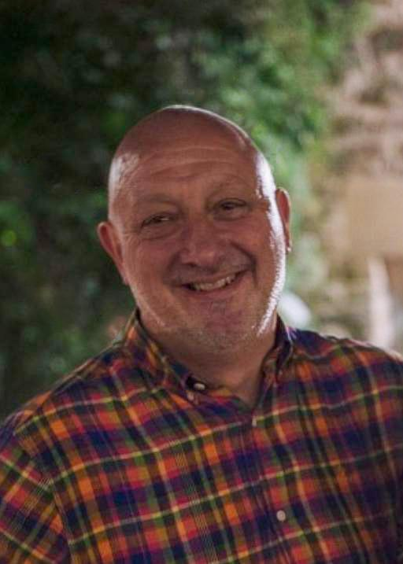
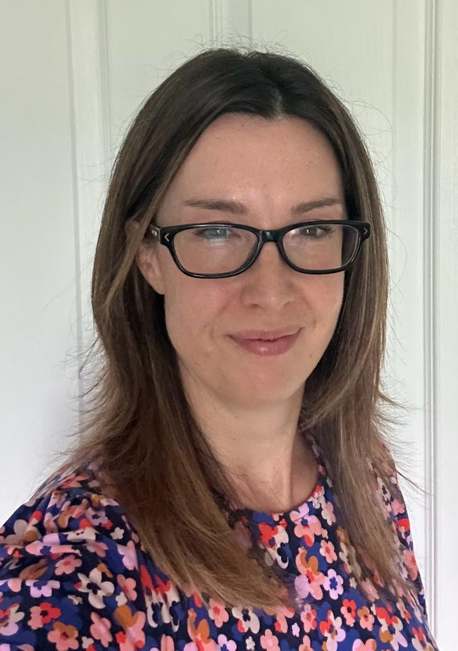
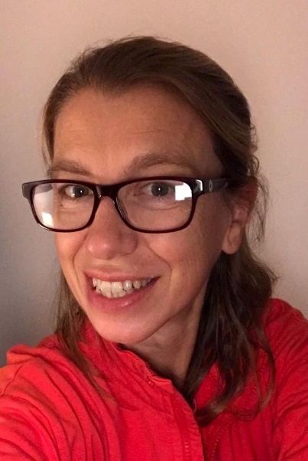
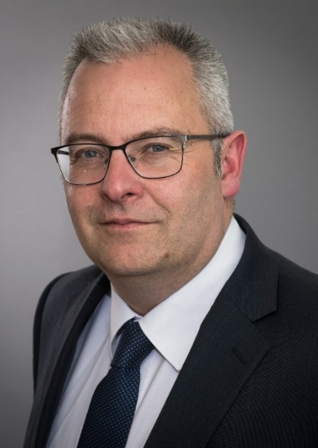
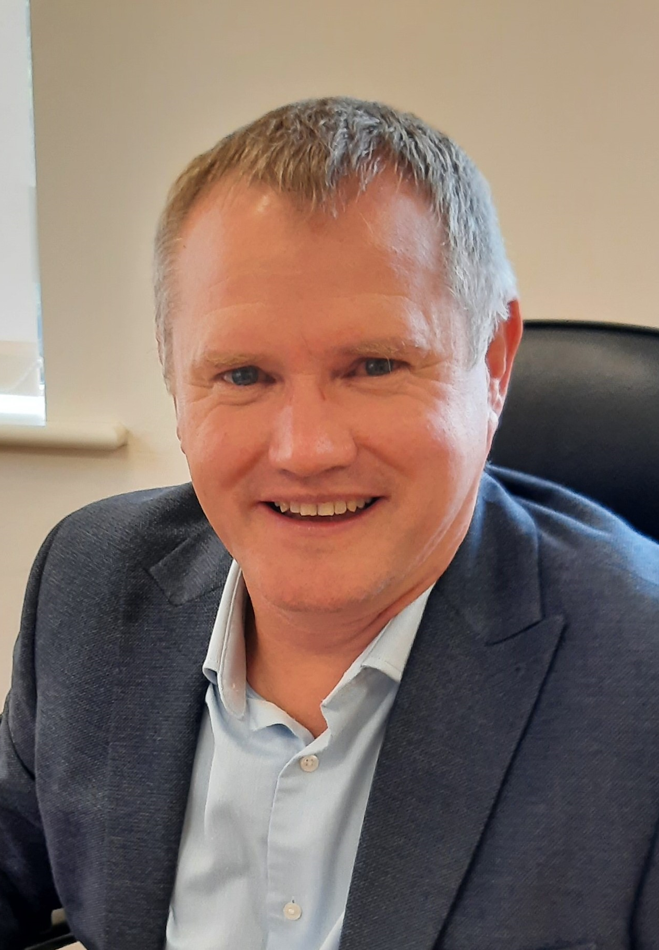
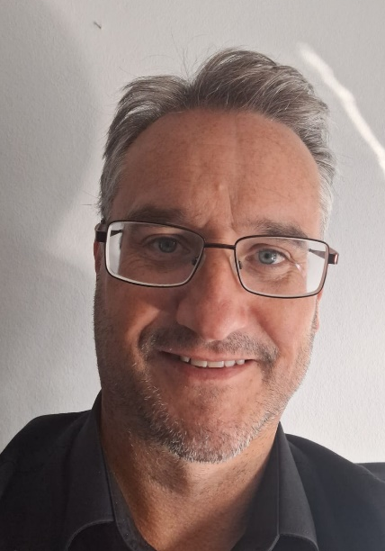
NYC Planning Service Leadership Team
Trevor Watson
Assistant Director Planning
Linda Marfitt
Head of Planning Policy & Place
Tracey Rathmell
Head of Delivery & Infrastructure
Martin Grainger
Head of Development Management
Rob Harper
Head of Building Control
Dave Clothier
Planning Operations Manager

Slide 2
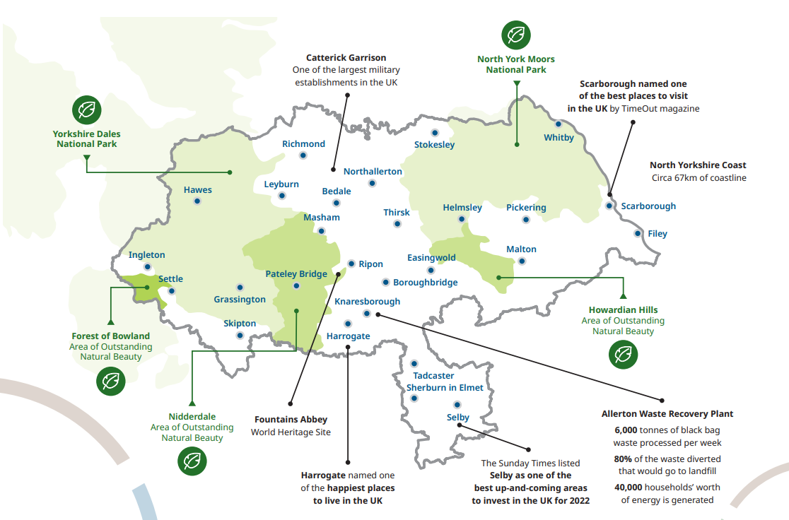
A new Planning Service for North Yorkshire – the story so far…
New Committee structure implemented
Safe & Legal processes and decisions
Work has started on a new Local Plan
Staff working together across the new geography
Programme of transition and transformation
Maximising opportunities of coming together as one council

Slide 3
A new Local Plan for North Yorkshire
Scoping, informal engagement, evidence base, call for sites
Regulation 18 consultation on options - growth strategy, policies and sites
Consider consultation responses, refinement of evidence
Regulation 19 consultation (draft plan/preferred options)
Submission of the Local Plan to the Secretary of State
Independent Examination
Adoption 2028
Full local plan for the whole area within 5 years
Minimum 15 Year plan period
Robust evidence base
Early engagement

Slide 4
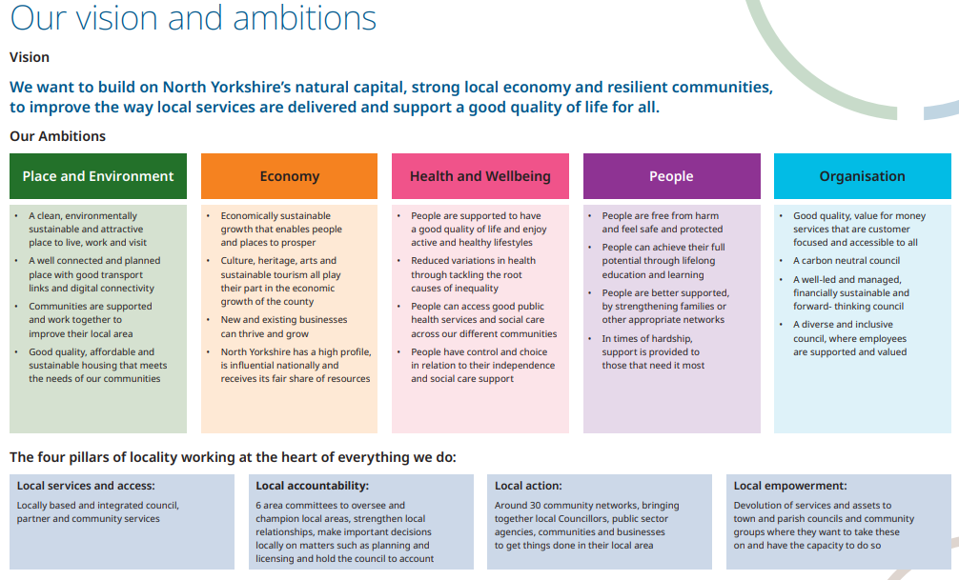
Key issues for the new local plan
A New Sustainable Growth Strategy
Large plan area – local focus
Economic & housing growth ambition
Places that work for people
Linking to other key strategies & evidence
Key economic centers & drivers
Climate change
Infrastructure opportunities & constraints
Design codes
Natural & built environment
Notes:
Linda

Slide 5
Next Steps for the new Local Plan
Statement of Community Involvement out to consultation in October
Finalise the Local Development Scheme before end 2023 (Exec sign off)
Set out a programme of early engagement
Start bringing together the evidence base (including HEDNA)
Issue call for sites consultation
Start to develop growth options
Prepare for Issues and Options consultation (Reg 18)
Continuous, proactive work on site and infrastructure delivery to support the implementation of current plans

