Slide 1
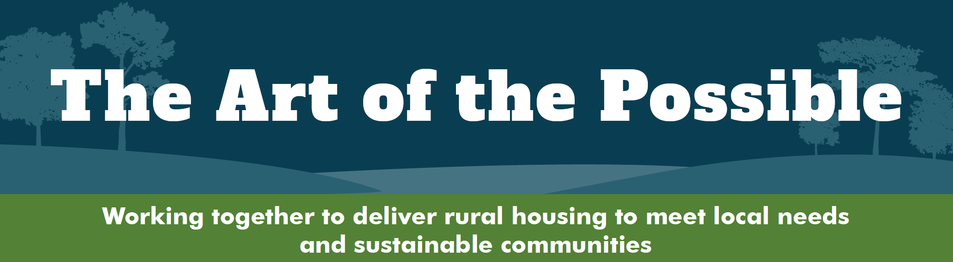

Hovingham Estate
7th November 2022
Hovingham Estate and the development of a sustainable community
Sir William Worsley

Slide 2
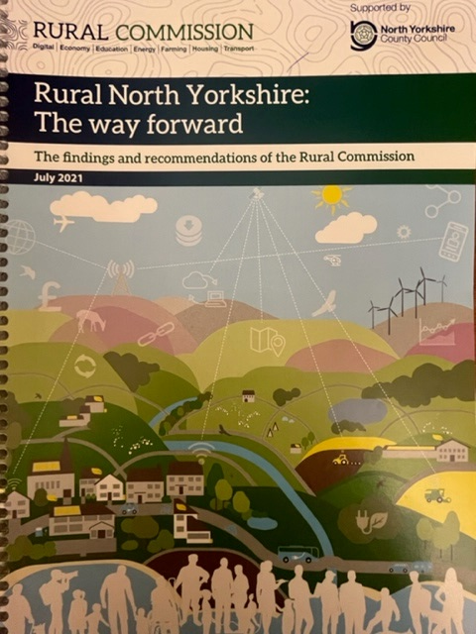

RURAL COMMISSION
Each Parish should build 5 houses over 10 years
40% should be affordable or available for rental
Design is key to uptake
“Our sincere hope is that…all dimensions of the county will be able to unite around its vision”
Chair the Very Revd John Dobson DL

Slide 3
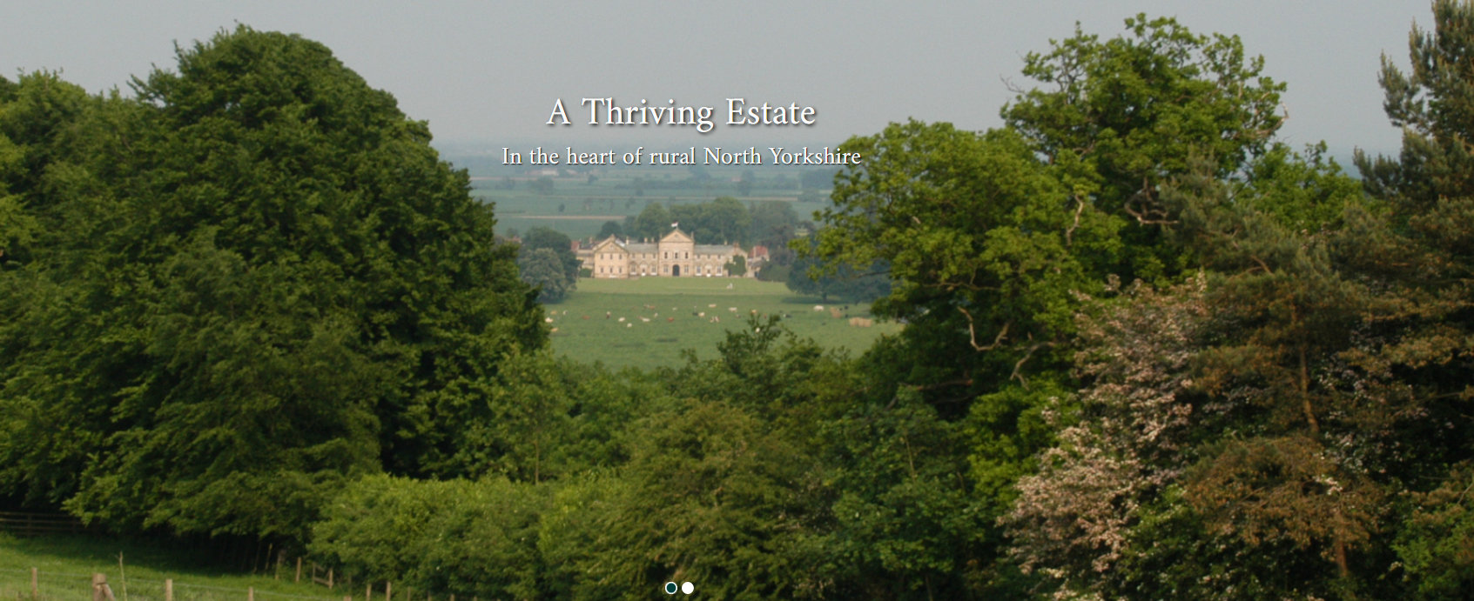
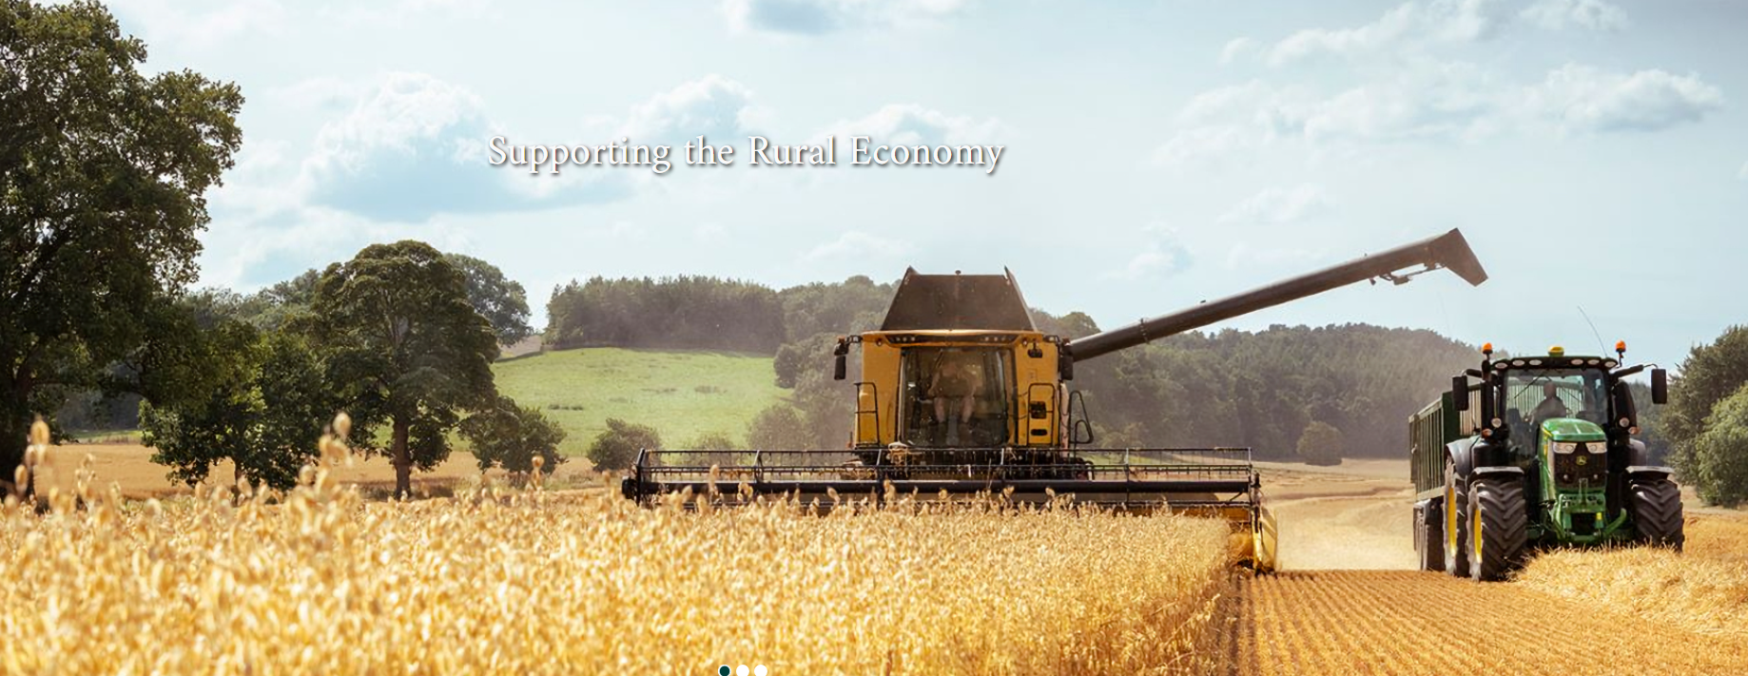
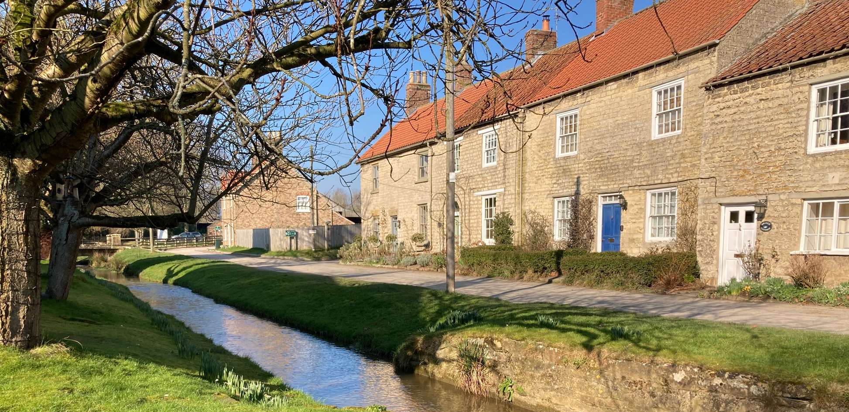
HOVINGHAM Estate Overview
Hovingham Estate has been in the ownership of the Worsley family since 1563
The Estate comprises a single block centred on the village of Hovingham in North Yorkshire, predominantly within the Howardian Hills Area of Outstanding Natural Beauty
The Estate businesses include farming, woodland, a hotel, a quarry and numerous residential and commercial properties
The Estate encourages good quality rural housing development phased over a number of years

Slide 4
RESIDENTIAL DEVELOPMENT SINCE 1950
Hovingham is a historic village but over half of the houses have been built since WW2
Little and often - phased development since 1950 has added 80 houses to the village
New houses all designed in the local vernacular, almost entirely pantile over limestone construction and subject to ongoing restrictive covenants
Good services – shop, bakery, café, doctor, hairdresser, pub, hotel, village hall, school, playground
Farming is at the heart of the village

Slide 5
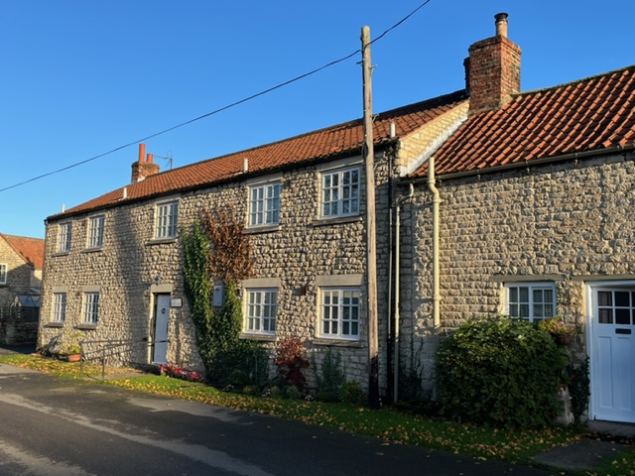
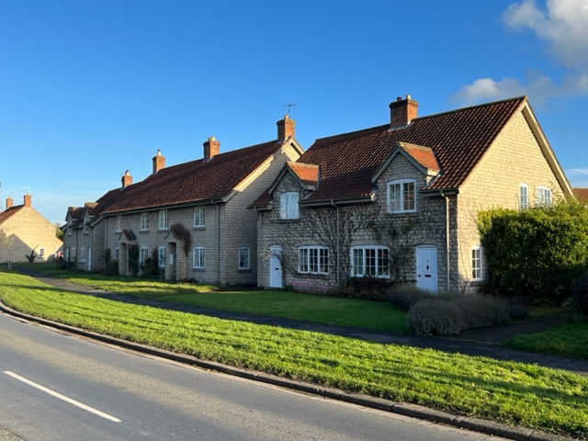
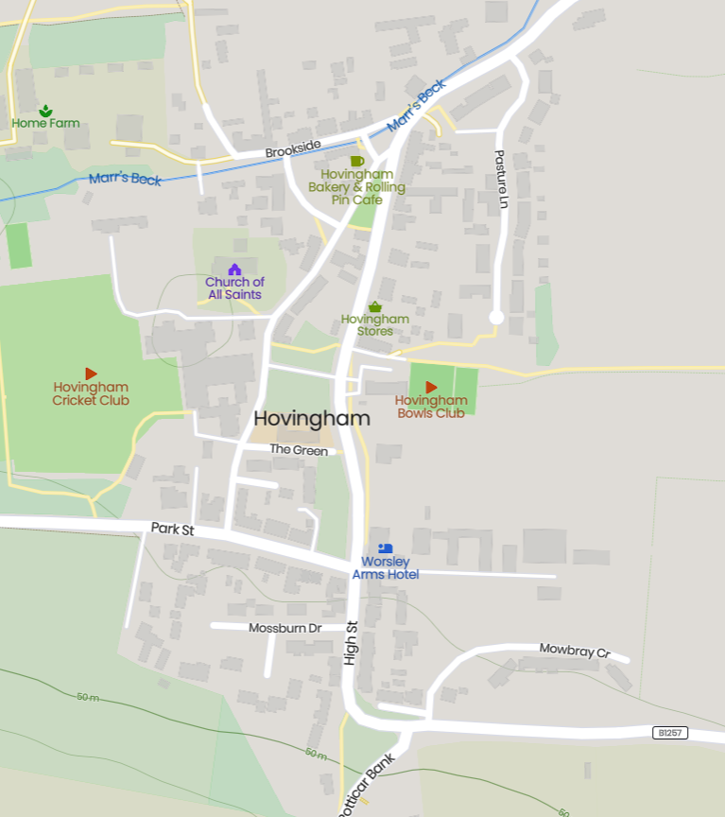

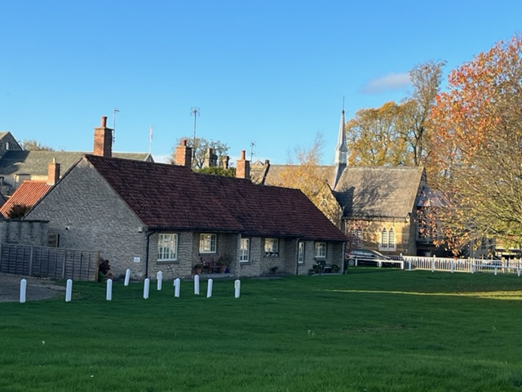
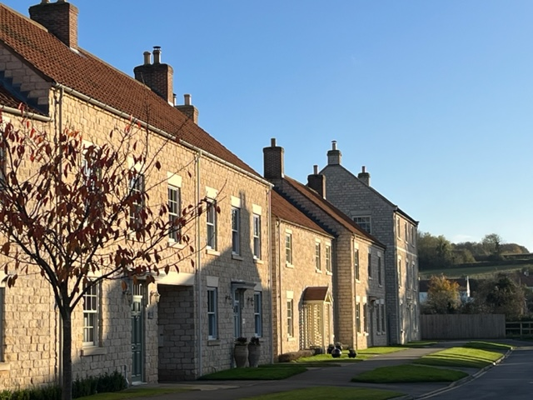
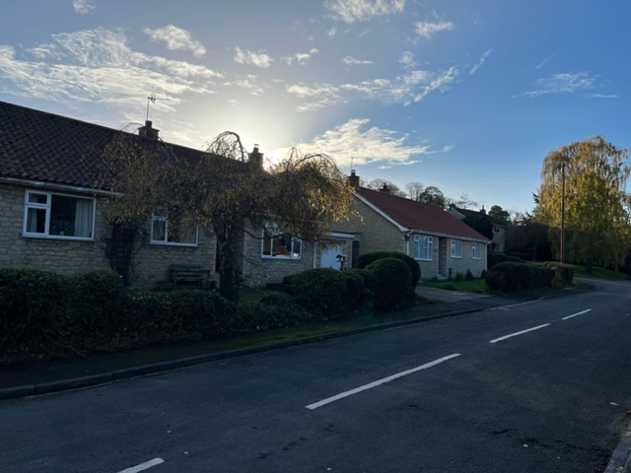
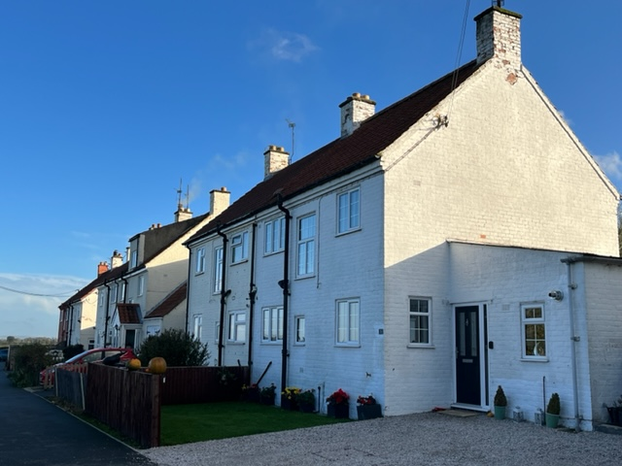
THE DEVELOPMENT OF HOVINGHAM

Slide 6
ESTATE HOUSING STRATEGY
We live here
We care about the service we provide as a landlord
Significant historic burden
Economic challenge for rural estates
Good design comes at a cost
Learn the lessons of the post war housing schemes
Affordable housing developments often ignore the issues of economic viability
Such developments must be economically viable for landowner and developer
“My family has a long association with Hovingham and as with my predecessors I maintain a desire to positively encourage and manage the success of the village as a wonderful place to live and work”

Slide 7
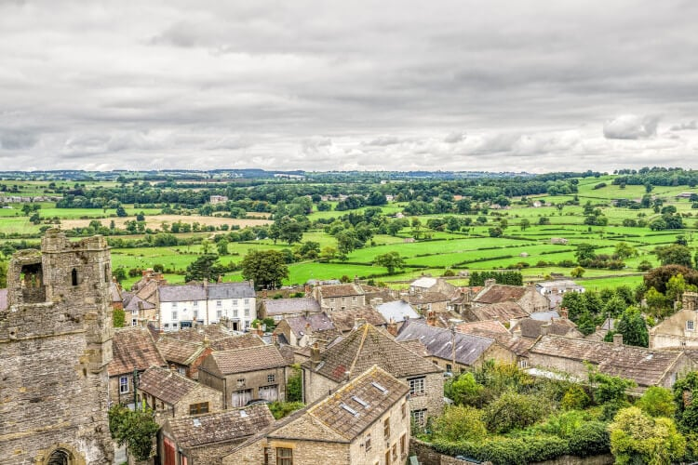
RURAL HOUSING – THE WAY FORWARD
What is rural planning?
Working together
Local authority, landowner, community
Long term vision

Slide 8
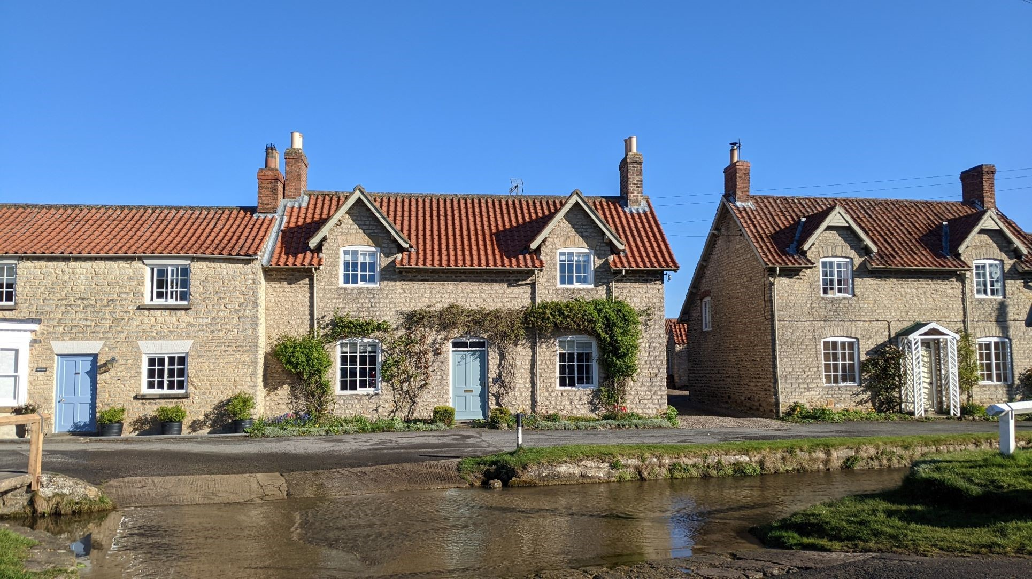
CONCLUSION
Sustainable community
Living Thriving Vibrant
Good design
Remember the economics
Mixed integrated communities

