Slide 1
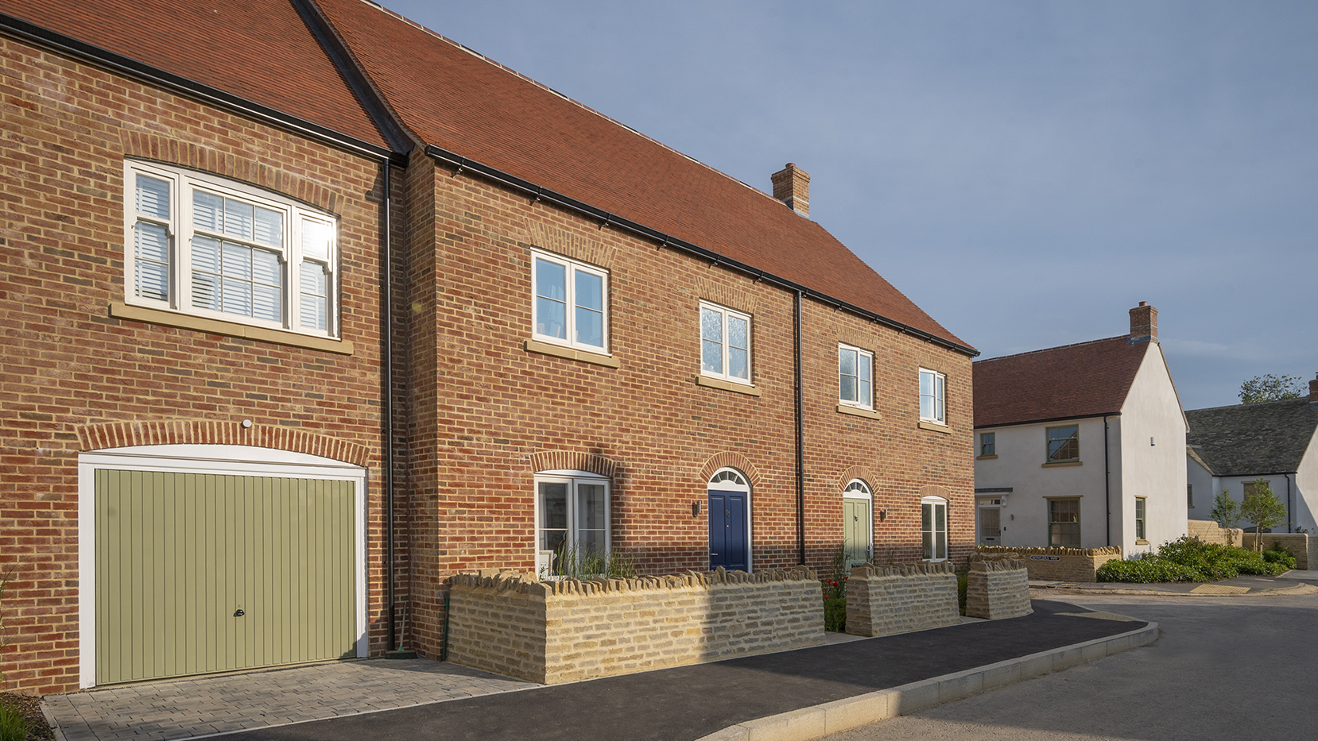

Affordable Housing -
An Estate Perspective
Presented by Roger File
Notes:
Good morning – I am Roger File the Managing Director of the Blenheim Real Estate Businesses

Slide 2
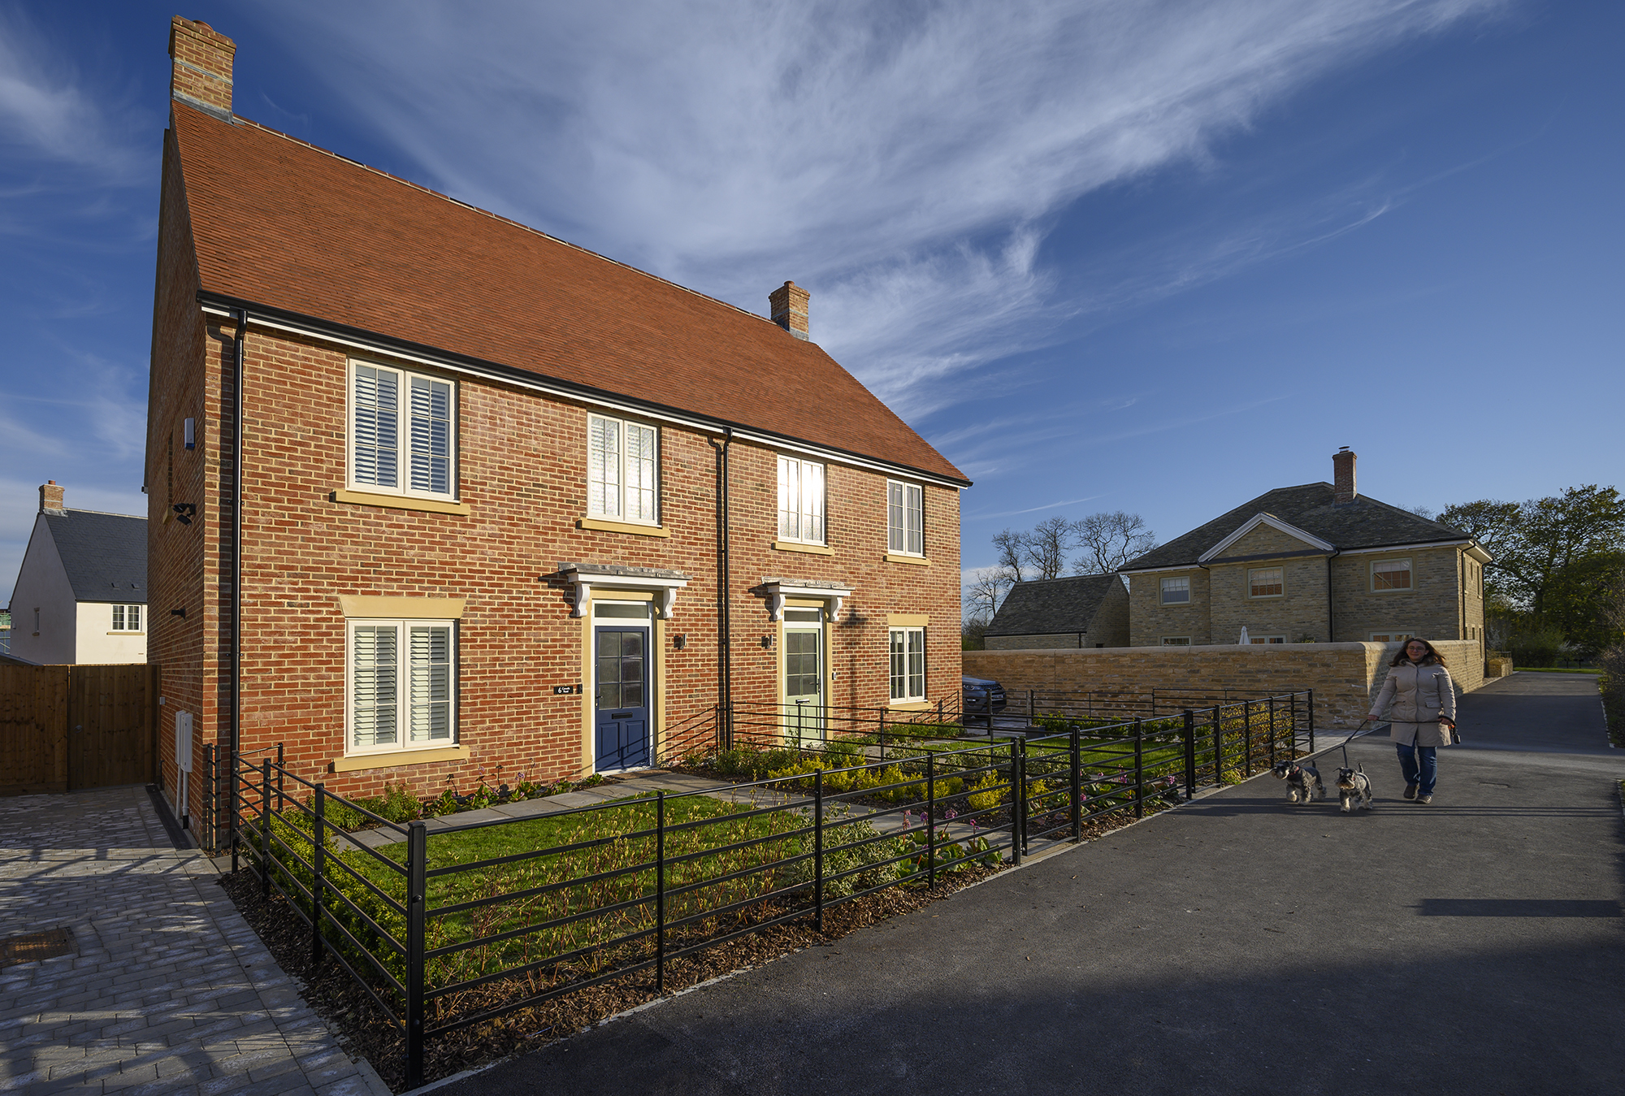


Today’s presentation
What is Blenheim?
Our purpose
Why we provide affordable homes and how
The challenges
Notes:
Today I am going to talk about – 4 things

Slide 3
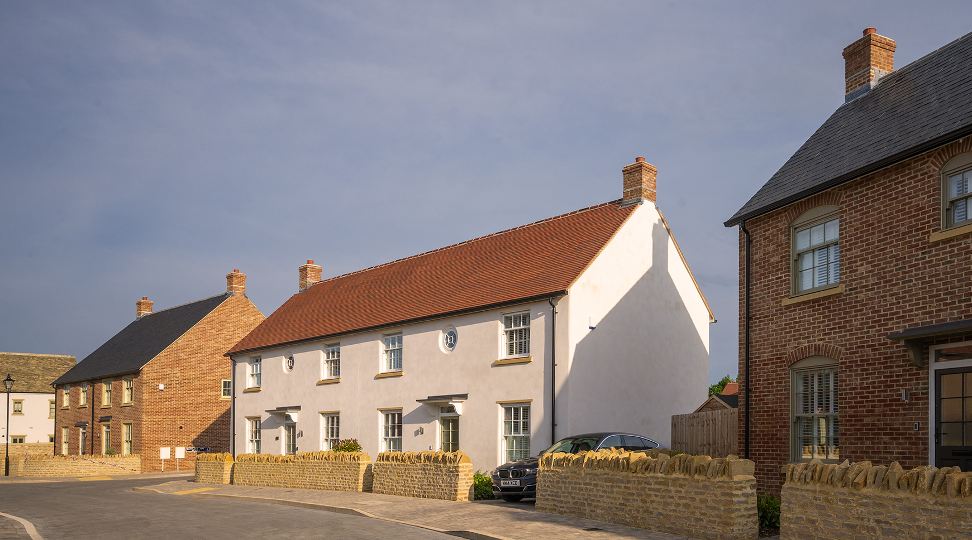
Blenheim – Who we are
Well located in Woodstock, Oxfordshire, a traditional Cotswold town which historically had low levels of affordable homes available
The Blenheim Landed Estate
  The Palace & formal gardens
  10,000 acres farmland
  400 homes
  Commercial portfolio
Our business has 3 pillars
  Visitor attraction
  Rural Estate business
  Real Estate Business: - Investment/Construction/Land Promotion and Strategic Planning
Notes:
So WHO ARE BLENHEIM - we are a LANDED ESTATE in a high value area – WITH –
Palace and gardens
10k acres farmland,
400 homes
Commercial portfolio
OUR BUSINESS is in 3 separate pillars –
VISITORS BUSINESS – 2019 – 1m visitors
Estate Business – the land
REAL ESTATE – 4 areas – INVESTMENT/BECL/PYE/BSP
I want to take you back to our PURPOSE

Slide 4
Our Purpose
"We believe that our core purpose is to be the lifeblood of the local economy,
to enhance the lives of the people of Oxfordshire,
to protect and share this magnificent place for future generations.“
Notes:
So several years ago we had a management change – we sat and wondered about our RELEVANCE in todays world
50 years ago – The Lord of the Manor could ………………………………………. TODAY the world is very different – AT WORST ITS LOOKED DOWN UPON AS A PLAY THING FOR THE RICH
SO We came up with this as being our PURPOSE in an attempt to give us relevance today – WHICH IS

Slide 5




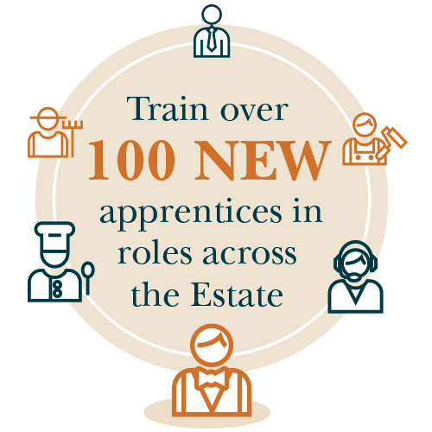
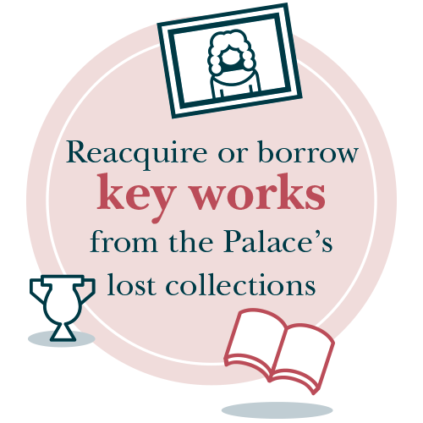
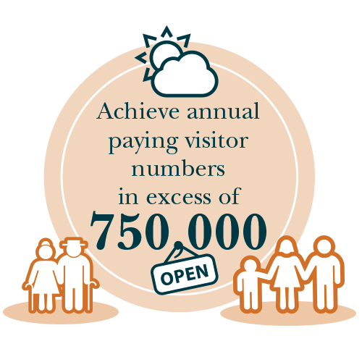



Our 10 Goals
Notes:
So, to give OUR PURPOSE a tangible manifestation we came up with our 10 goals
SO one of our goals is to deliver AFORDABLE HOUSING

Slide 6
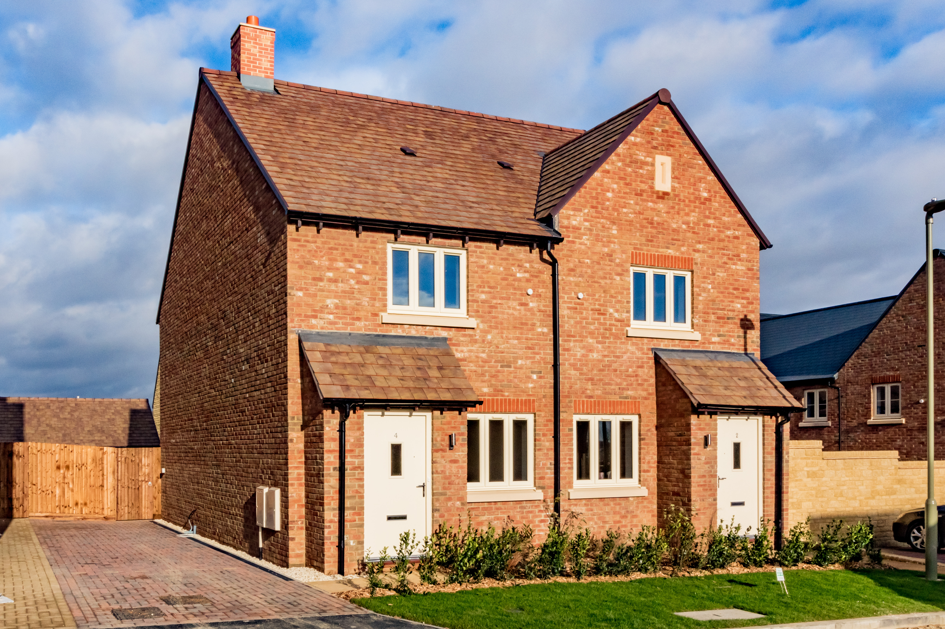
Why we have chosen to own and provide affordable homes
Investing in communities means local families can afford to live in the local area that they
grew up in
Affordable homes fit into Blenheim Estate strategy BUT legacy has made housing more unaffordable
Tenure blind design strengthens the community, improves social integration and protects property prices
We are holding for the long term as a strong asset on our balance sheet
Notes:
WHY have we chosen to deliver affordable housing
IT FITS OUR STRATEGY - I MENTIONED our PURPOSE - ….. To be the life blood etc Enhance the lives….. Protect and share …….
BUT
We are building very high value homes
Legacy principles (TALK A BIT MORE ABOUT) have added huge value making houses even less affordable £450 to £600psf
b) We believe AFFORDABLE HOUSING is an investment in our communities not a tax on developers, so people who have grown up in an area can afford to stay here
C) We deliberately build tenure blind to ………tenure blind – door knobs – to strengthen communities
D) There is a financial reason - we aim to hold for the long term, on our balance sheet, they give reasonable returns

Slide 7
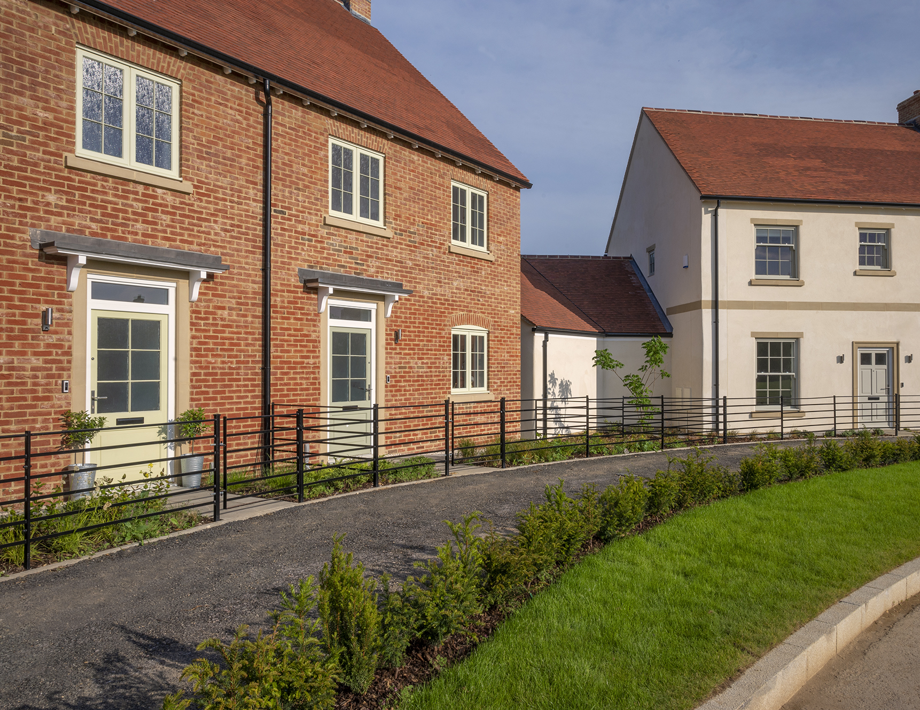
Which of these is an affordable home?
Notes:
Image of affordable homes, which do you think is the affordable home here?

Slide 8
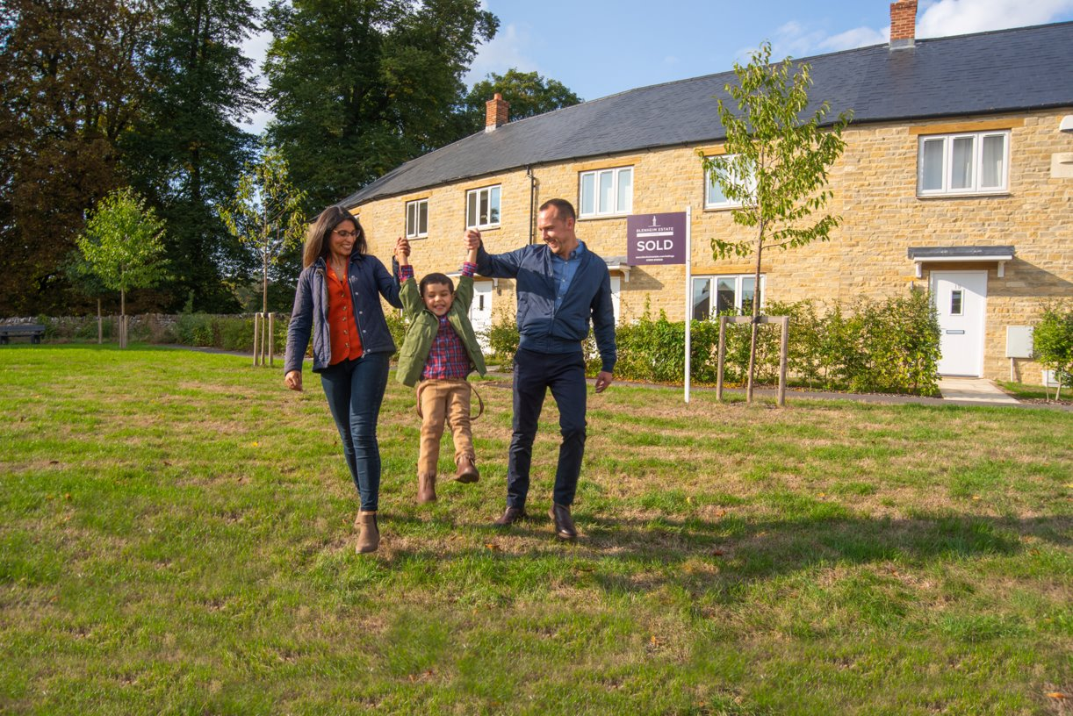

How do we provide homes?
Written into S106 agreements
Grant 5-year tenancies rather than assured shorthold tenancies
We have 20% of the affordable allocation for key workers
We retain pre-emption rights when staircasing reaches 100%
Notes:
We do it slightly differently from RSL’s
written into S106 agreements
- grant 5 years tenancies rather than AST’s
We have 20% of the affordable allocation for key workers – EXPANDED DEFINITION – tourism and leisure
We retain pre-emption rights

Slide 9

We deliver deeper discounts
40%
Discount on rental
50%
20%
Discount housing
association
Of the homes in our developments
are affordable homes
We generally are required to provide a 70/30 split of affordable rent and shared ownership
Notes:
AND - The Headline is
We do 40% discount on rental, housing assoc are 20%, illustrations to show differences
- 50% of the homes in our developments are affordable homes – 70/30 split

Slide 10
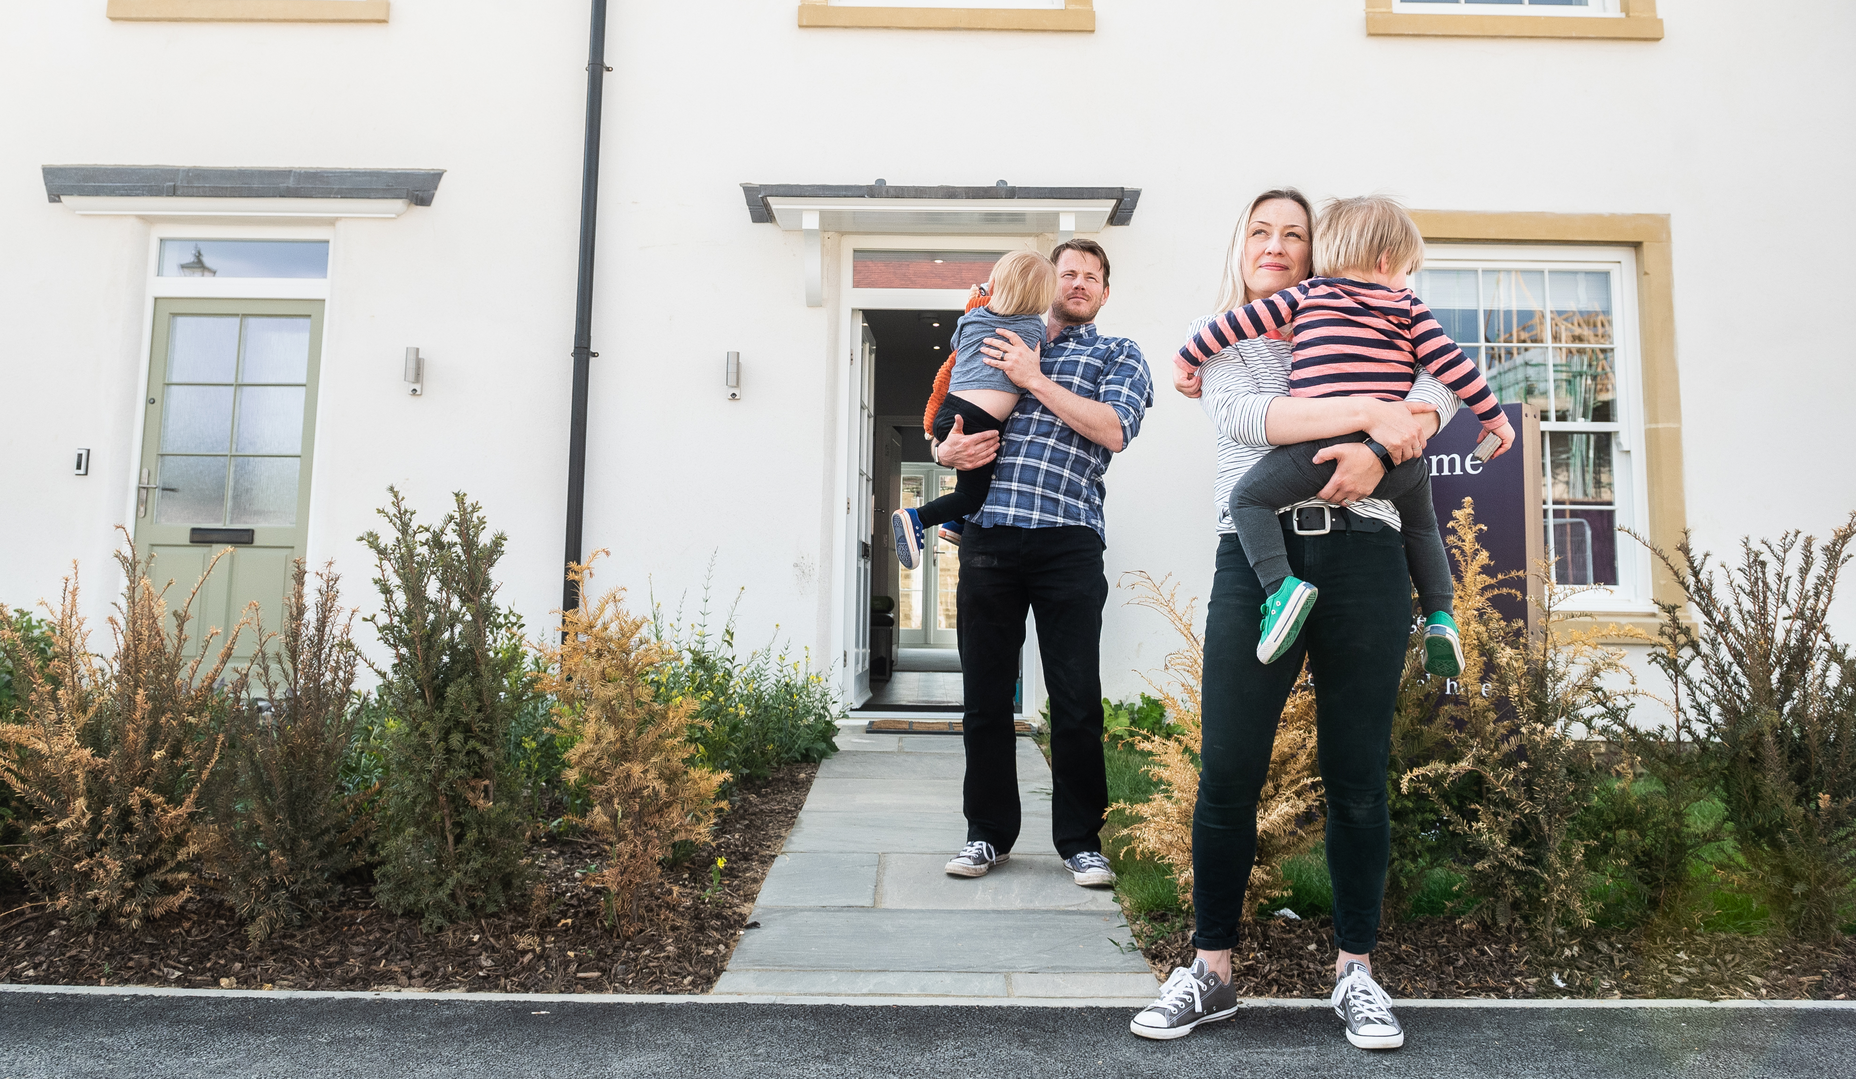
The practical operation
Tenant selection
Priority for local people OR those with local connection
WODC housing list
On Home Seeker Plus Scheme
Same selection criteria as RSL’s
Notes:
SO HOW DOES IT WORK
In terms of our TEAM –
we are already set up to manager housing AS ARE MOST LANDED ESTATES
We use the LA housing list
Their allocations platform and criteria

Slide 11
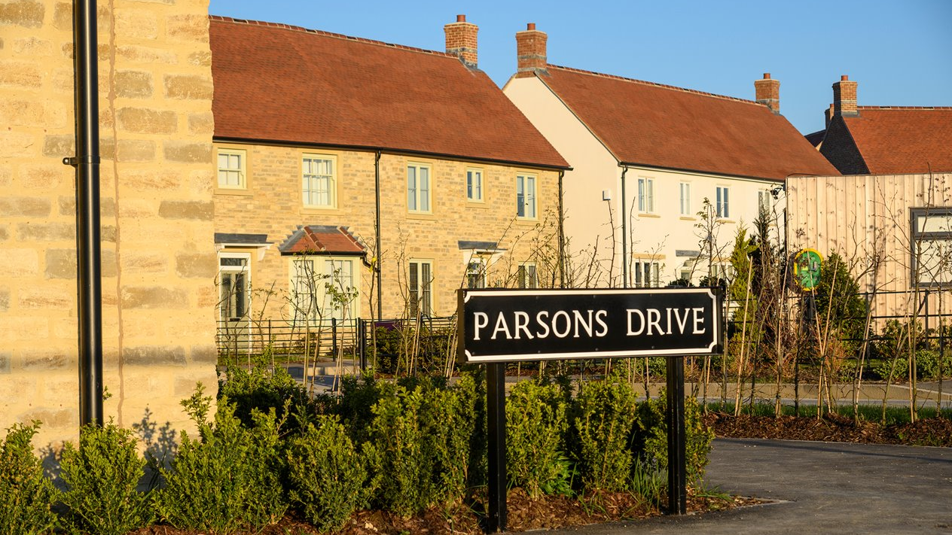
Resources
Lettings team
We already have that but added 1 housing officer
Additional maintenance
Finance support
Notes:
Makes sense for estates as we already have…..

Slide 12

The Financials
Notes:
So how do the numbers work –
WE HAVE NOW COMPLETED OUR FIRST SCHEME OF 169 houses – 59 Affordable + DOCTORS SURGERY –
WE have some real numbers to look at!!

Slide 13

How much we can keep on
the Blenheim Estates balance sheet
Notes:
SO - We have to deploy capital for profit –
AT THE BEGINNING OF EACH PROJECT –
WE AIM TO KEEP AS MUCH ON OUR BS AS POSSIBLE

Slide 14

3 Bedroom
2 Bedroom
Home
Home
£1850
£1100
£1600
£960
Market
Rent
Affordable Rent
Market
Rent
Affordable Rent
£9000
£7680
Cost saving
Per Year Per Home
Cost saving
Per Year Per Home
The Financials
How it stacks up
Notes:
So this is what it looks like for the local occupier

Slide 15
Financials
Returns excluding land cost
Returns including
land cost
Gross target: 9.2%
Actual: 8.3%
Gross target: 6.9%
Actual: 6.4%
Net target: 7.7%
Actual: 6.6%
Net target: 5.8%
Actual: 5.1%
Notes:
These a preliminary and
we expect to improve with economies of scale
These are Income yields – ignore capital growth = CPI + 1 our friend
Assumes equity receipts offset debt
We have a whole host of initiatives as an Estate and Business to address the Climate Change Agenda – including

Slide 16
Challenges
We are transparent and realistic about the challenges to deliver affordable housing
Impact of
inflation
Small percentage of high maintenance tenants
Fuel poverty
Housing benefit cap
Notes:
Inflation – cost of living rents linked to CPI + 1
CLIMATE CHANGE

Slide 17
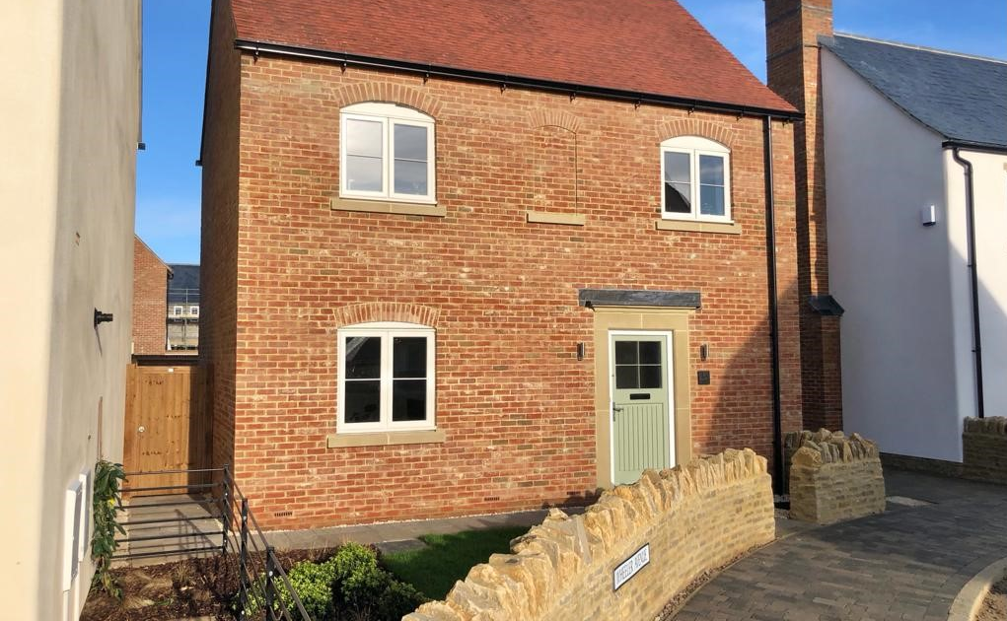
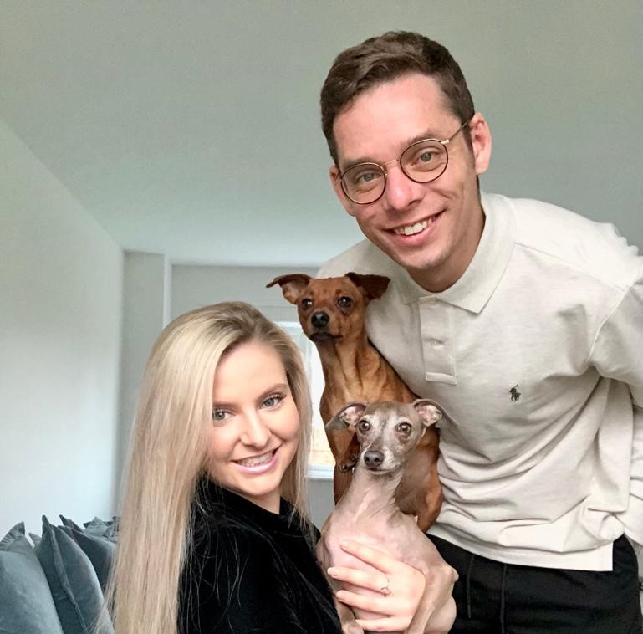
“When the opportunity of shared ownership became available
at Park View, we jumped at
the chance. Owning our first
perfect home together within
a community we know and love
has been a dream come true for us.”
Notes:
Quotes from affordable tenants + visuals

Slide 18
Key to delivery
Our Housing Officer
WODC
Homeseeker
Plus platform
Partnership with
West Oxfordshire District Council
Notes:
SO WHAT IS THE KEY TO OUR DELIVERY – 2 THINGS
Visual to show partnership with WODC using their homeseeker plus platform + plus our own housing officer – key to delivery

Slide 19
Awards
2021 Gold Winner
2021 Winner
Best Partnership Scheme with West Oxfordshire District Council
Public/Private Partnership Award winner with West Oxfordshire District Council
Notes:
Awards won

Slide 20
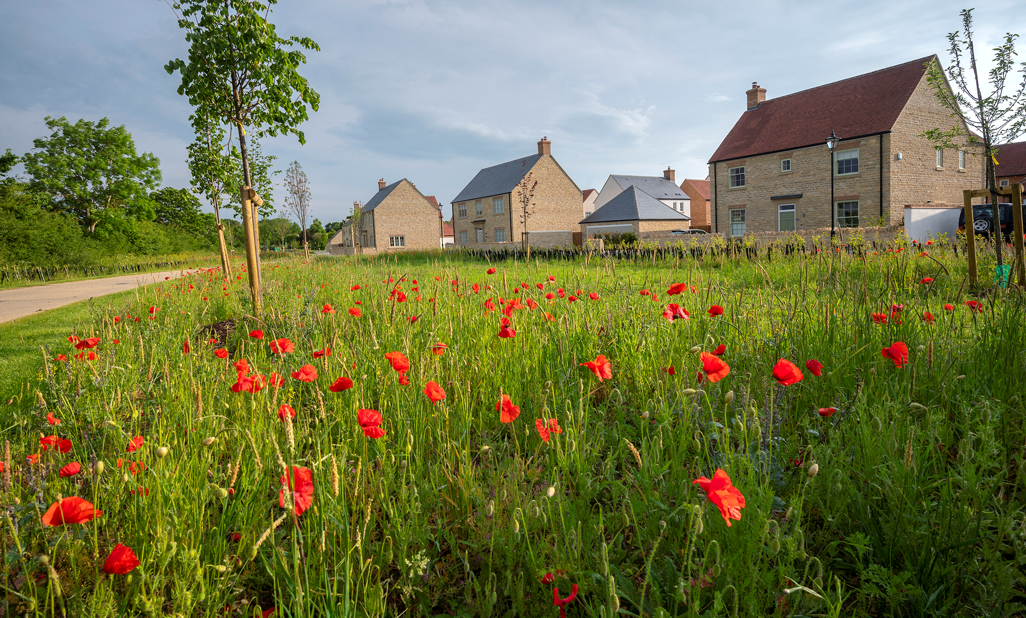
Thank you
Notes:
Thank you

