Slide 1
What is the Art of the Possible?

Slide 2
Who are Housing Associations?
We Are:
Regulated by the Regulator of Social Housing
Not for profit social landlords
Providers of homes for a range of people
Providers of services to customers and communities
Able to access Government grant to build affordable housing

Slide 3
We are not:
Commercial developers – although we think and act commercially to deliver effective services
Absentee landlords – we invest in our homes and communities
Landlords of last resort – we provide a range of products to meet a range of housing requirements
Providers of cheap and shoddy homes – we deliver quality new homes and invest in our stock

Slide 4
We can be:
Locally, regionally or nationally based
Specialist or generalist in focus
Holders of charitable status
Big or small
Ambitious for growth, or happy to manage homes

Slide 5
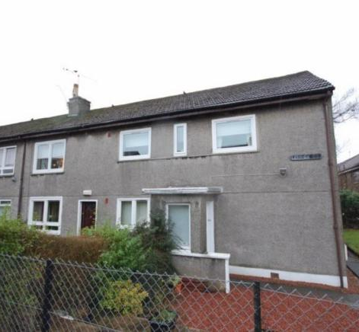
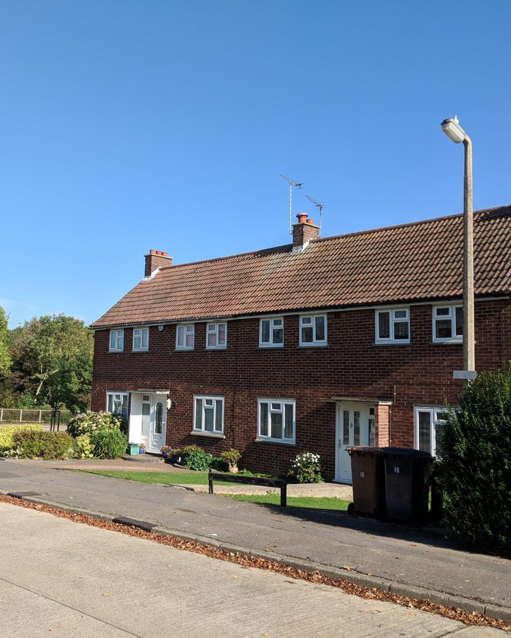
What does Affordable Housing look like?

Slide 6
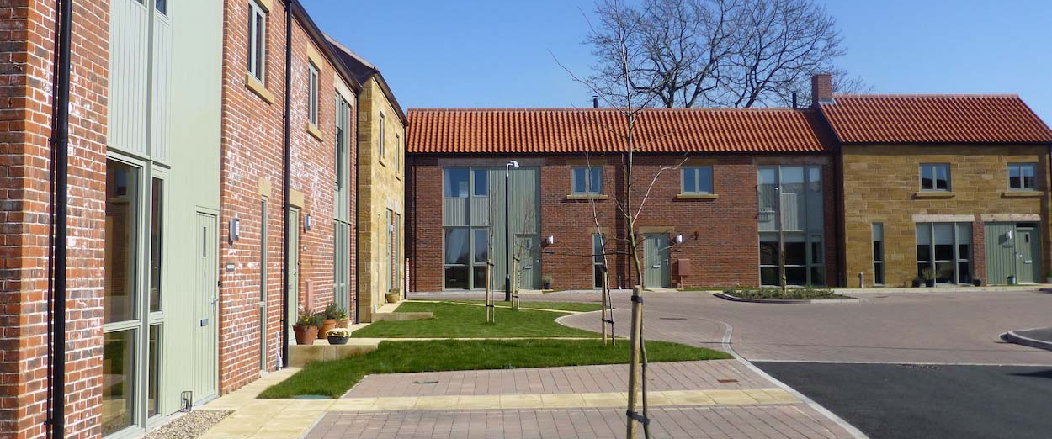
Or this?

Slide 7
A bit about Broadacres
Established in 1993, based in Northallerton we own and manage c6,500 homes in York and North Yorkshire
We are an exempt charity, Registered with the RSH and an Investment Partner with Homes England
We are the only major developing Housing Association with a North Yorkshire HQ, we specialise in rural housing delivery and have delivered 700 homes in the last 5 years
We provide excellent customer experience, delivering services and support locally and responsively
We have an ambitious development programme, with an aspiration to deliver 1,000 new homes in the next 5 years
And we’re investing £2M pa in improving the energy performance of our homes
We have the ambition to be ‘the best rural housing association’ with a focus on quality, sustainability and customer experience
Proud supporter of the N&ER Rural Housing Enablers – from the beginning
We’re here to stay in North Yorkshire!

Slide 8
Our offer to you
The brochure is just the beginning!
Illustration of the range of our offer (and that of our partner HAs)
Whatever your circumstances, whatever your requirements
Not just about the bricks and mortar either
Partnerships are key
Some further detail ‘from the expert!’

Slide 9
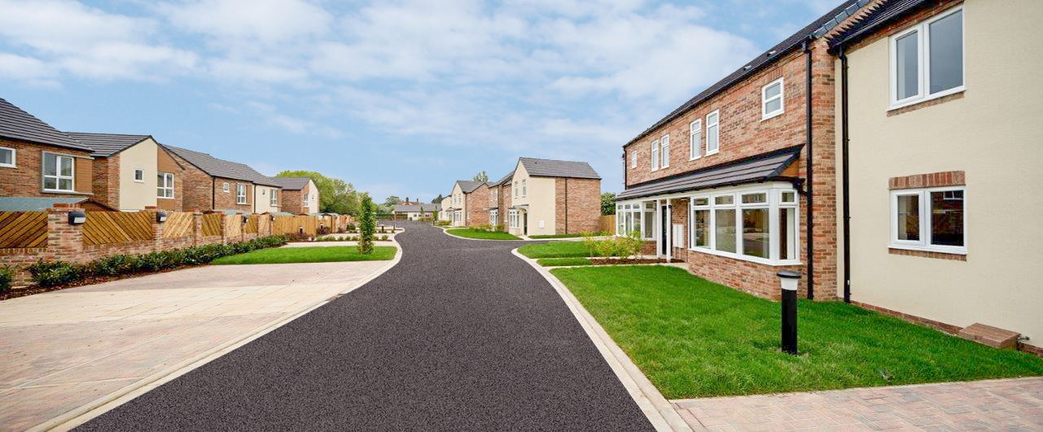
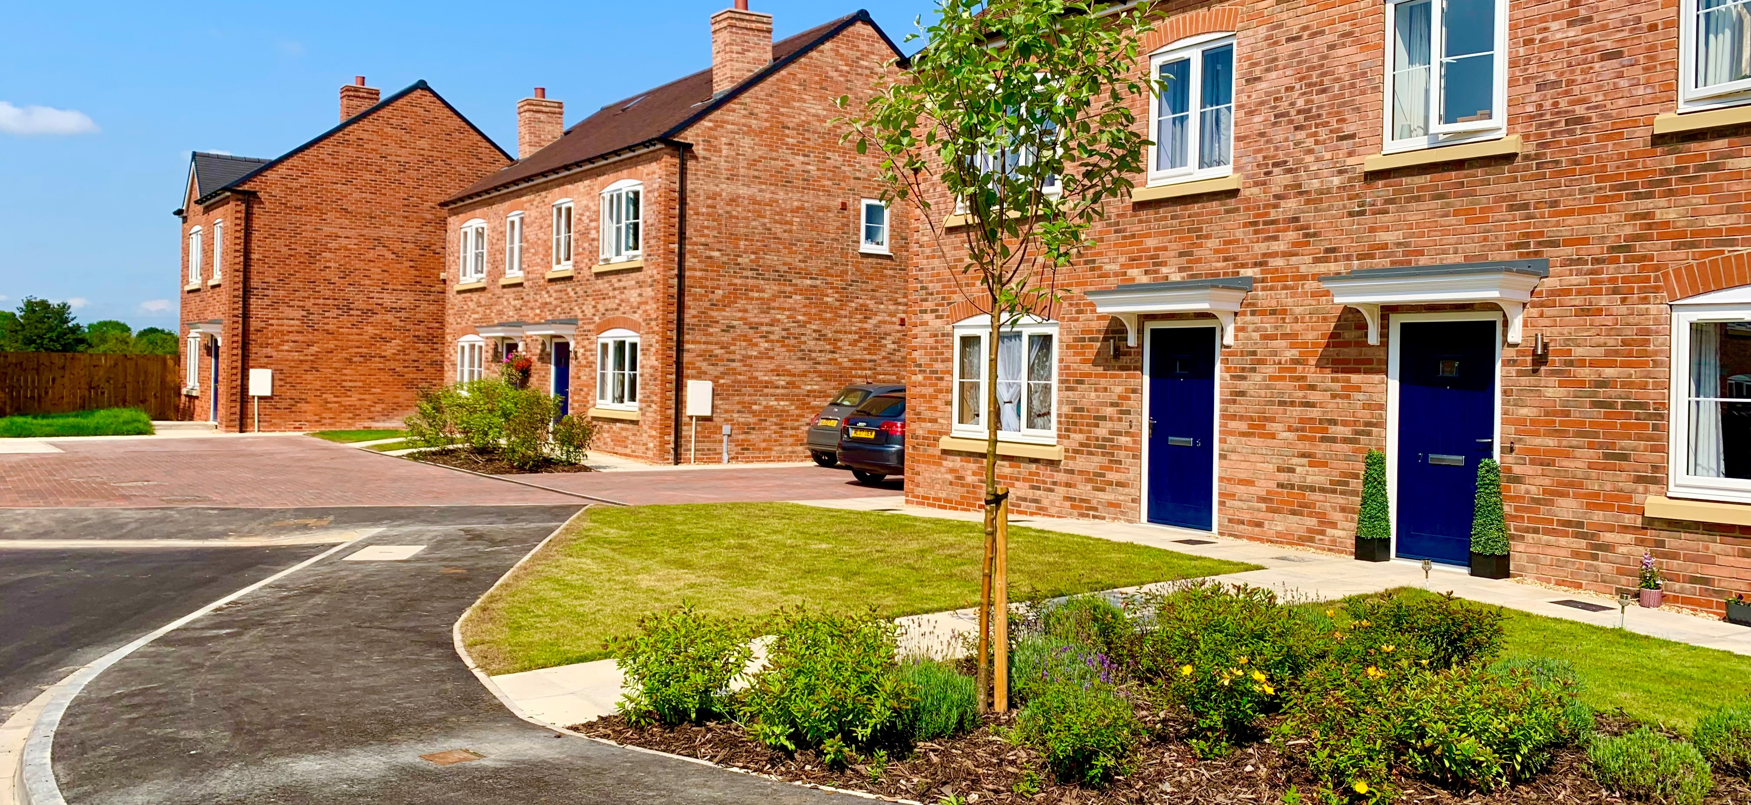
Rural Exception site and land led opportunities
Huby – development of 12 affordable homes
Hutton Rudby – development of 16 affordable homes

Slide 10
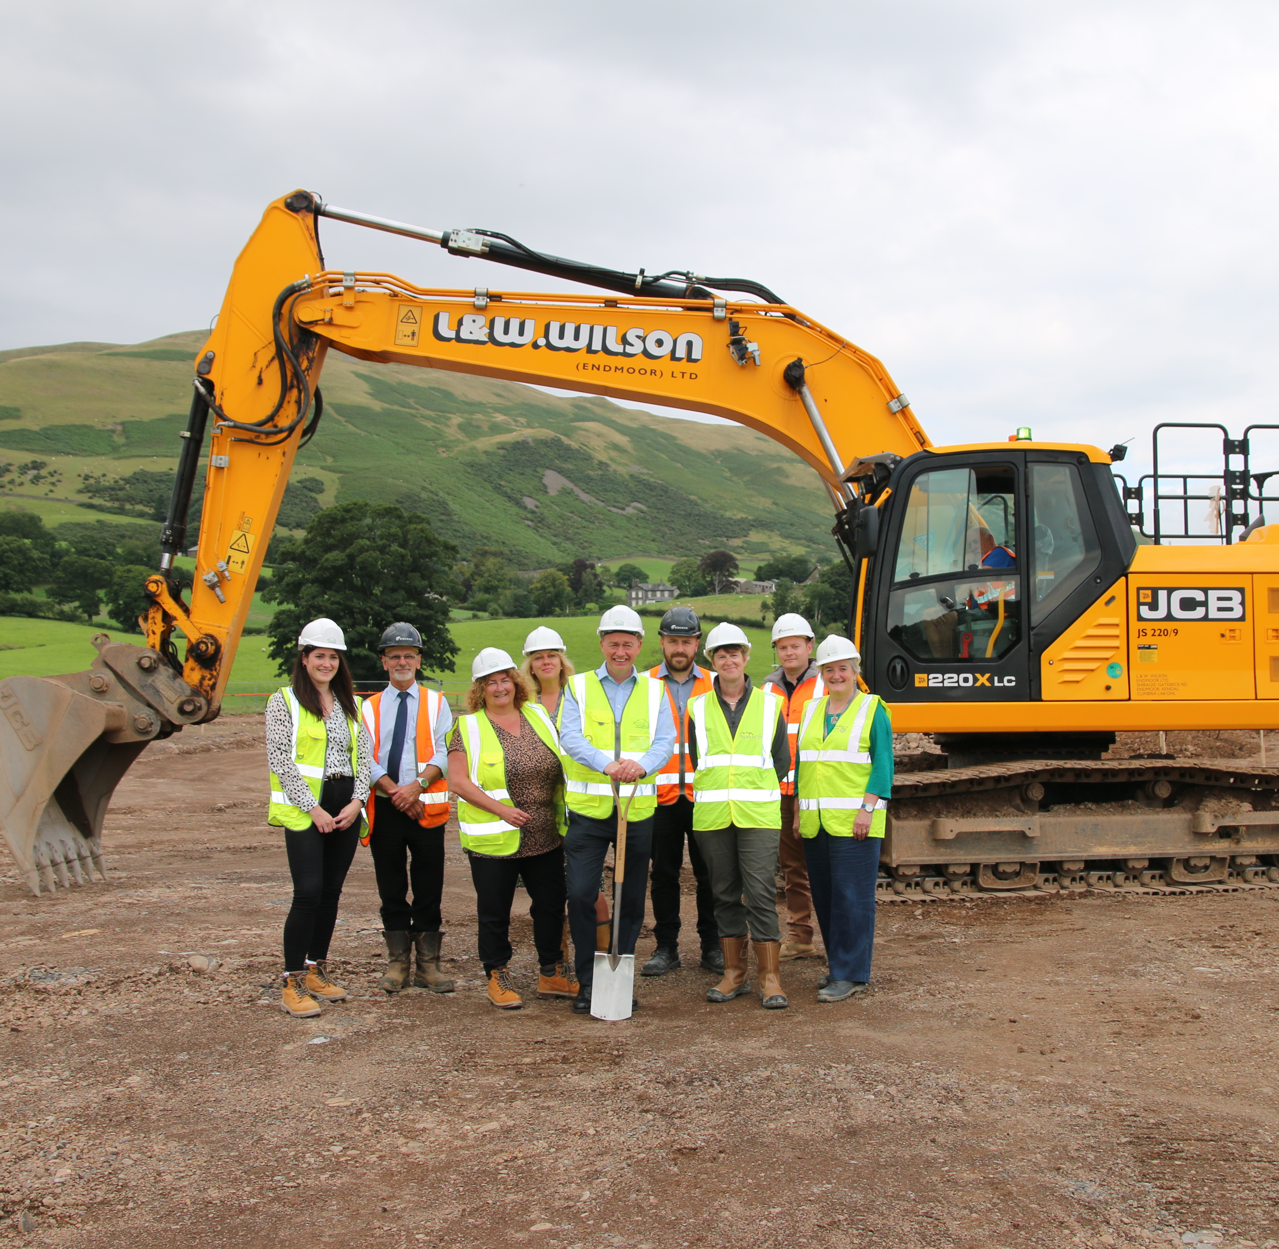
Unlocking stalled sites
Sedbergh – development of 49 homes utilising different local plan policies and mixed tenures.

Slide 11
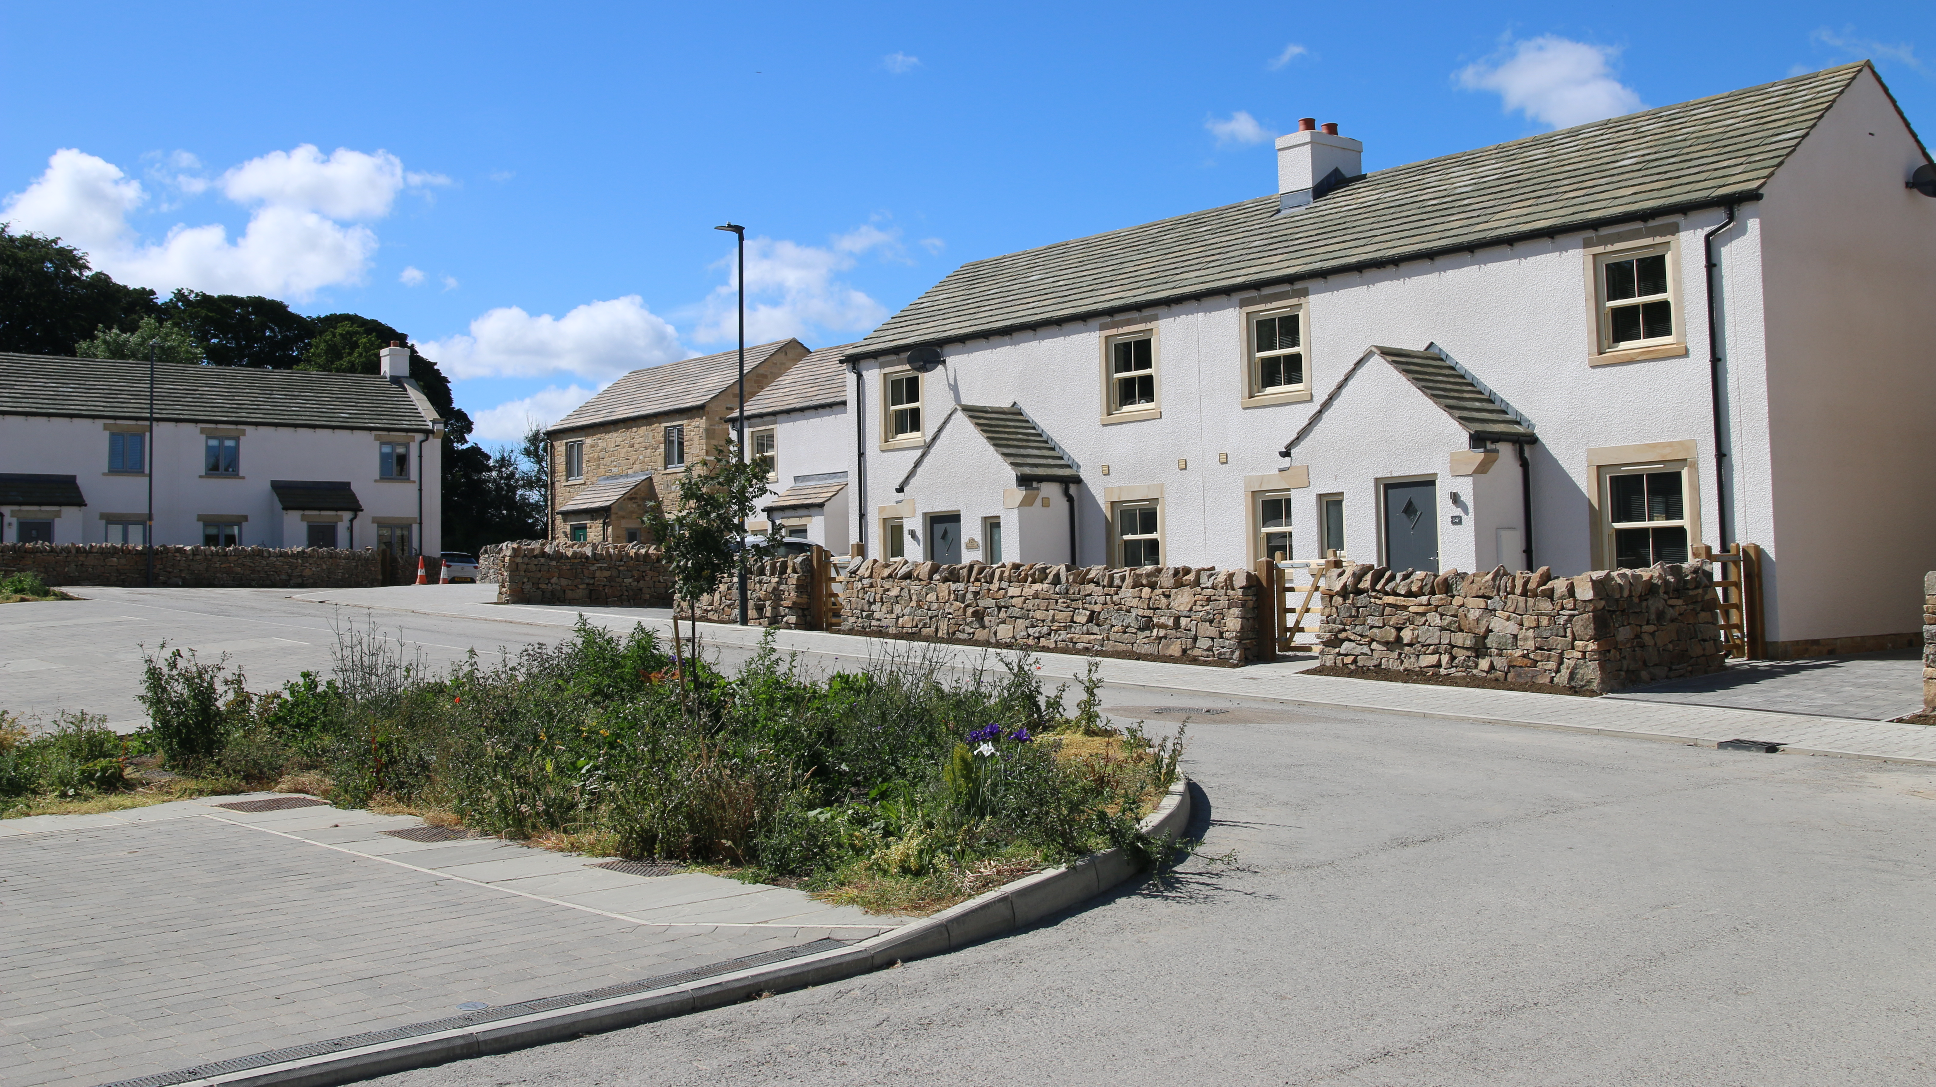
Working with Private developers
West Witton – working with developer to find a solution for affordable housing contribution requirement

Slide 12
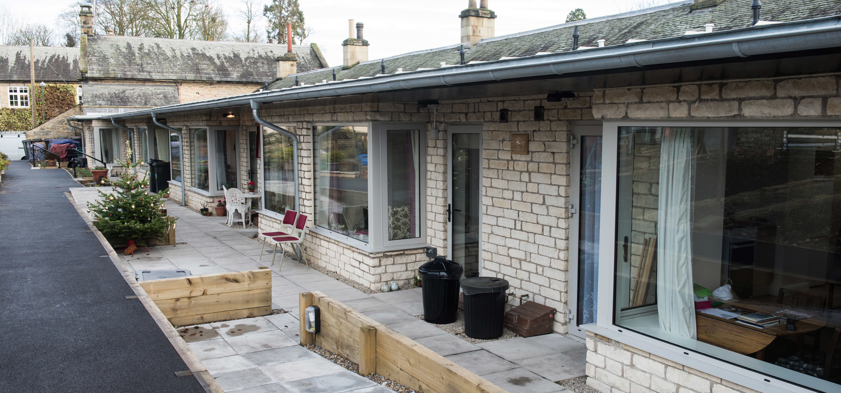
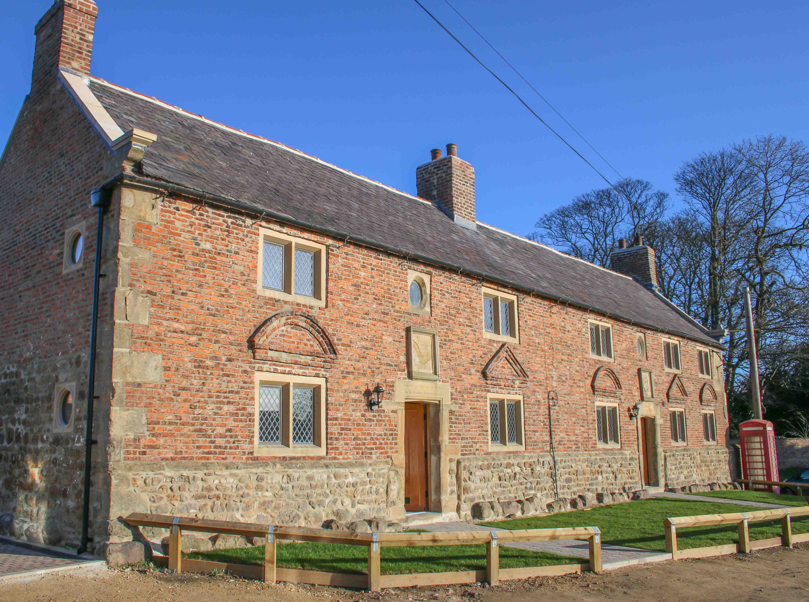
Providing development and management services
Lady Lumley Almshouse Trust, Thornton Le Dale
Matthew Robinson Trust, Burneston, Bedale

Slide 13
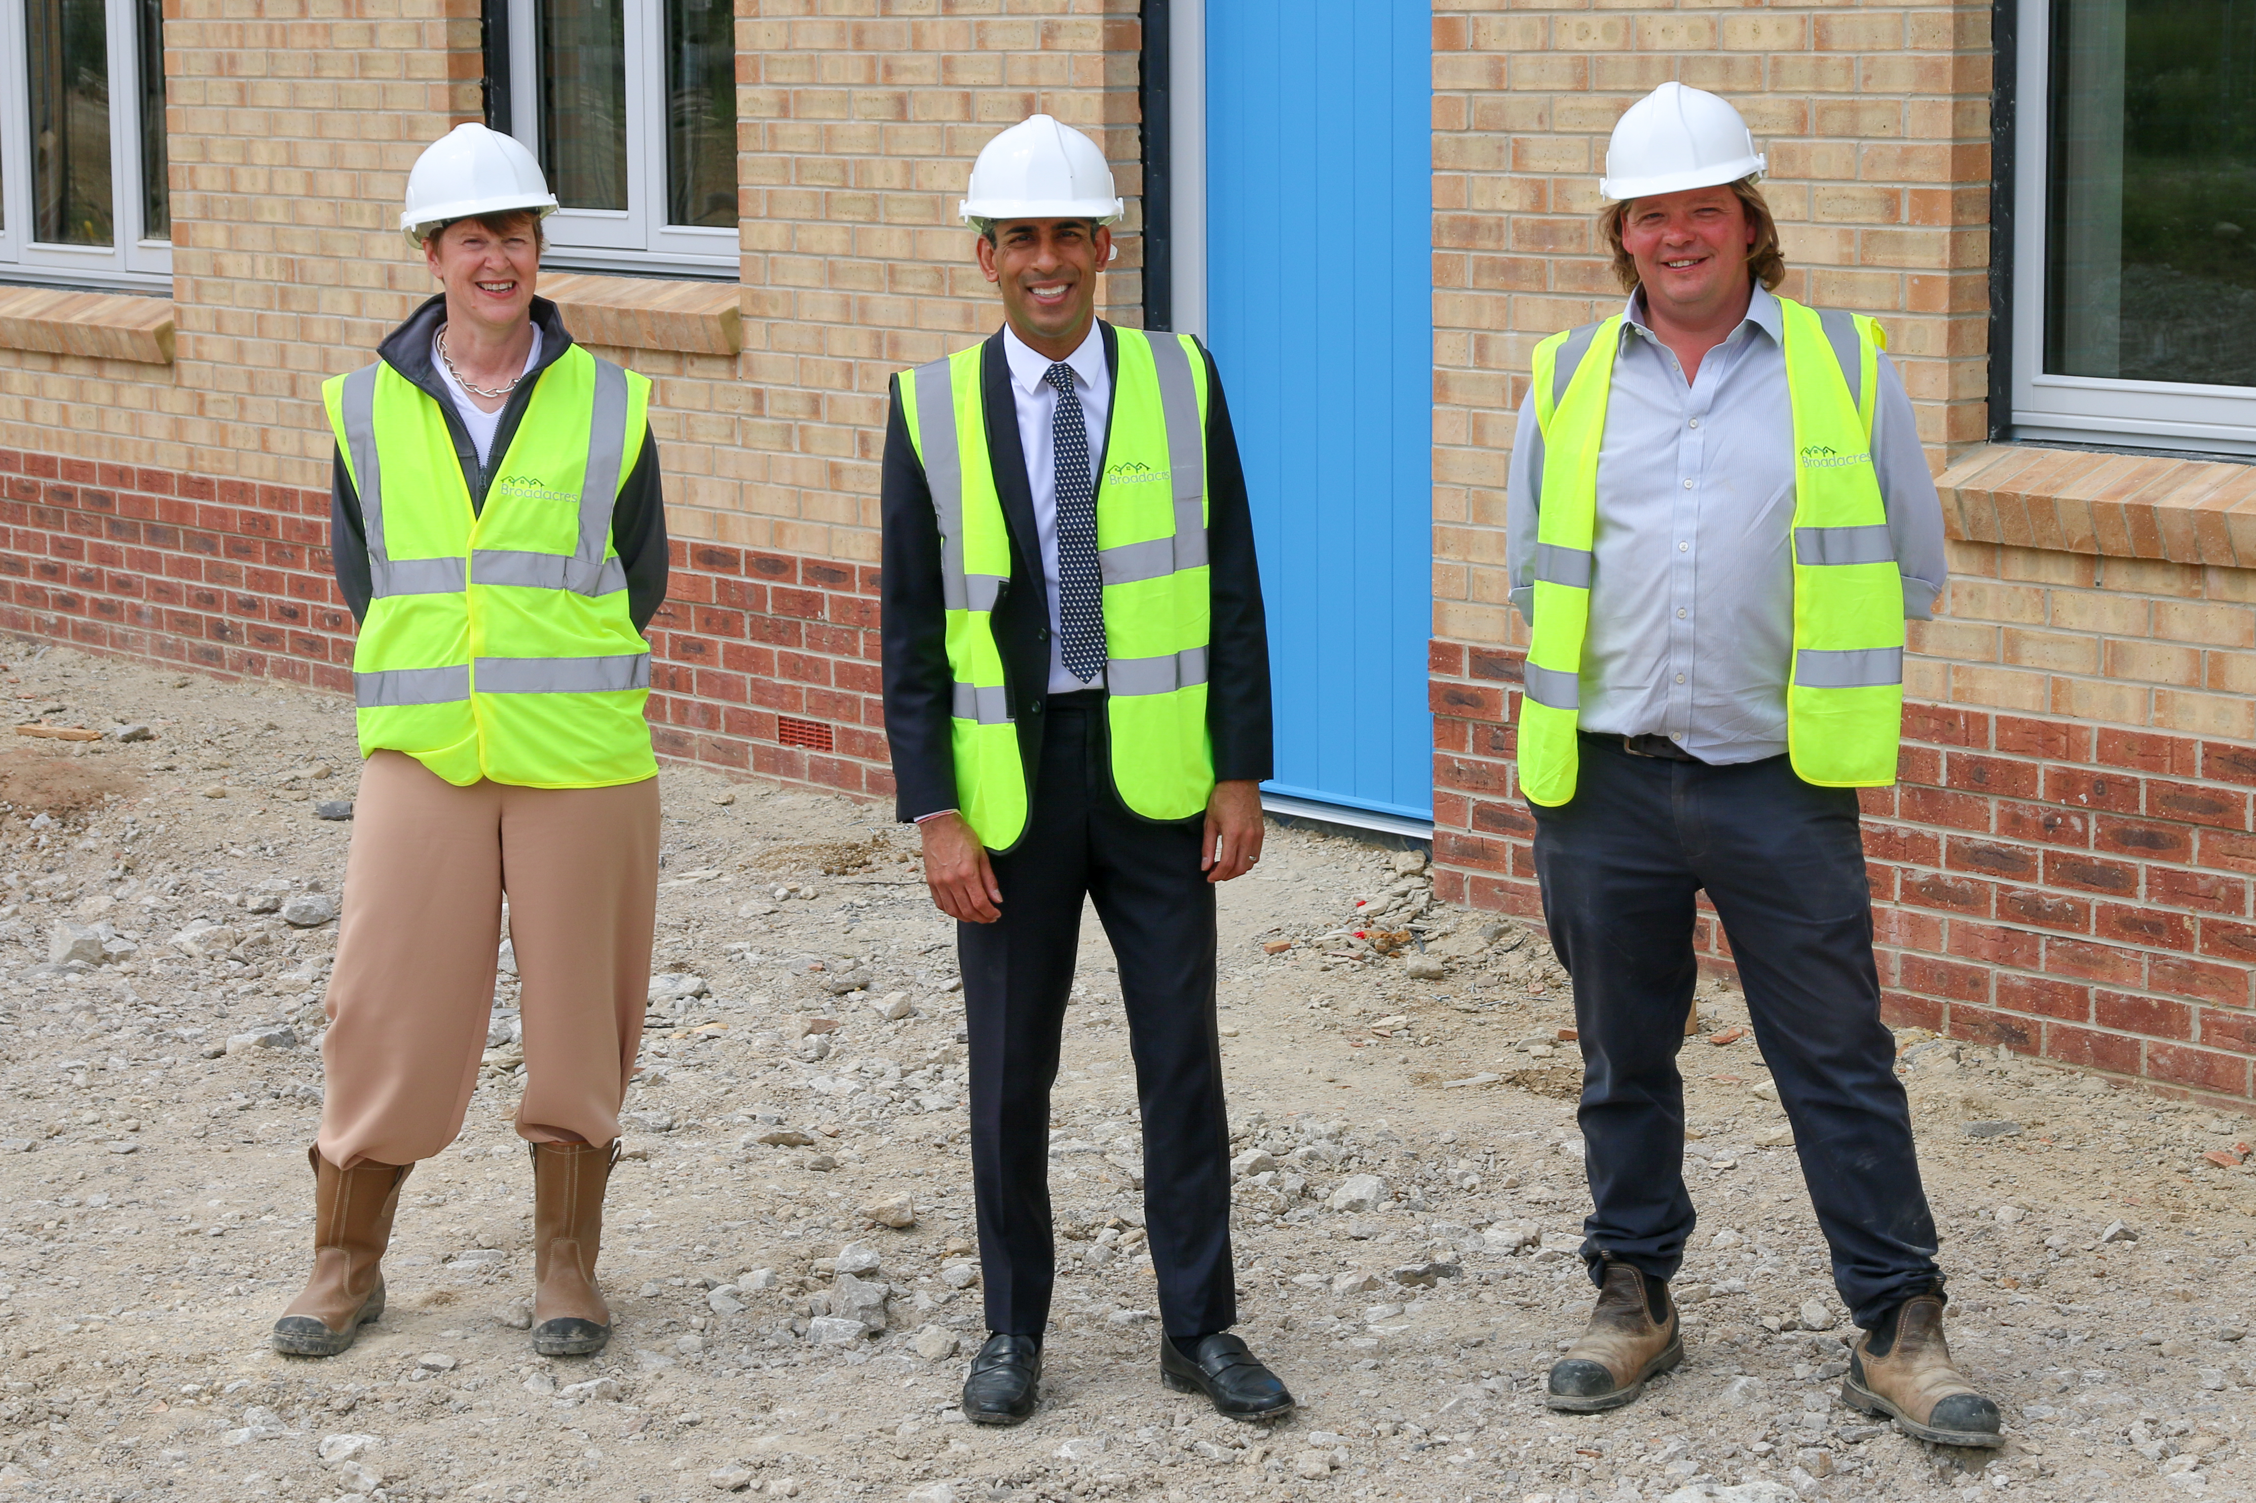
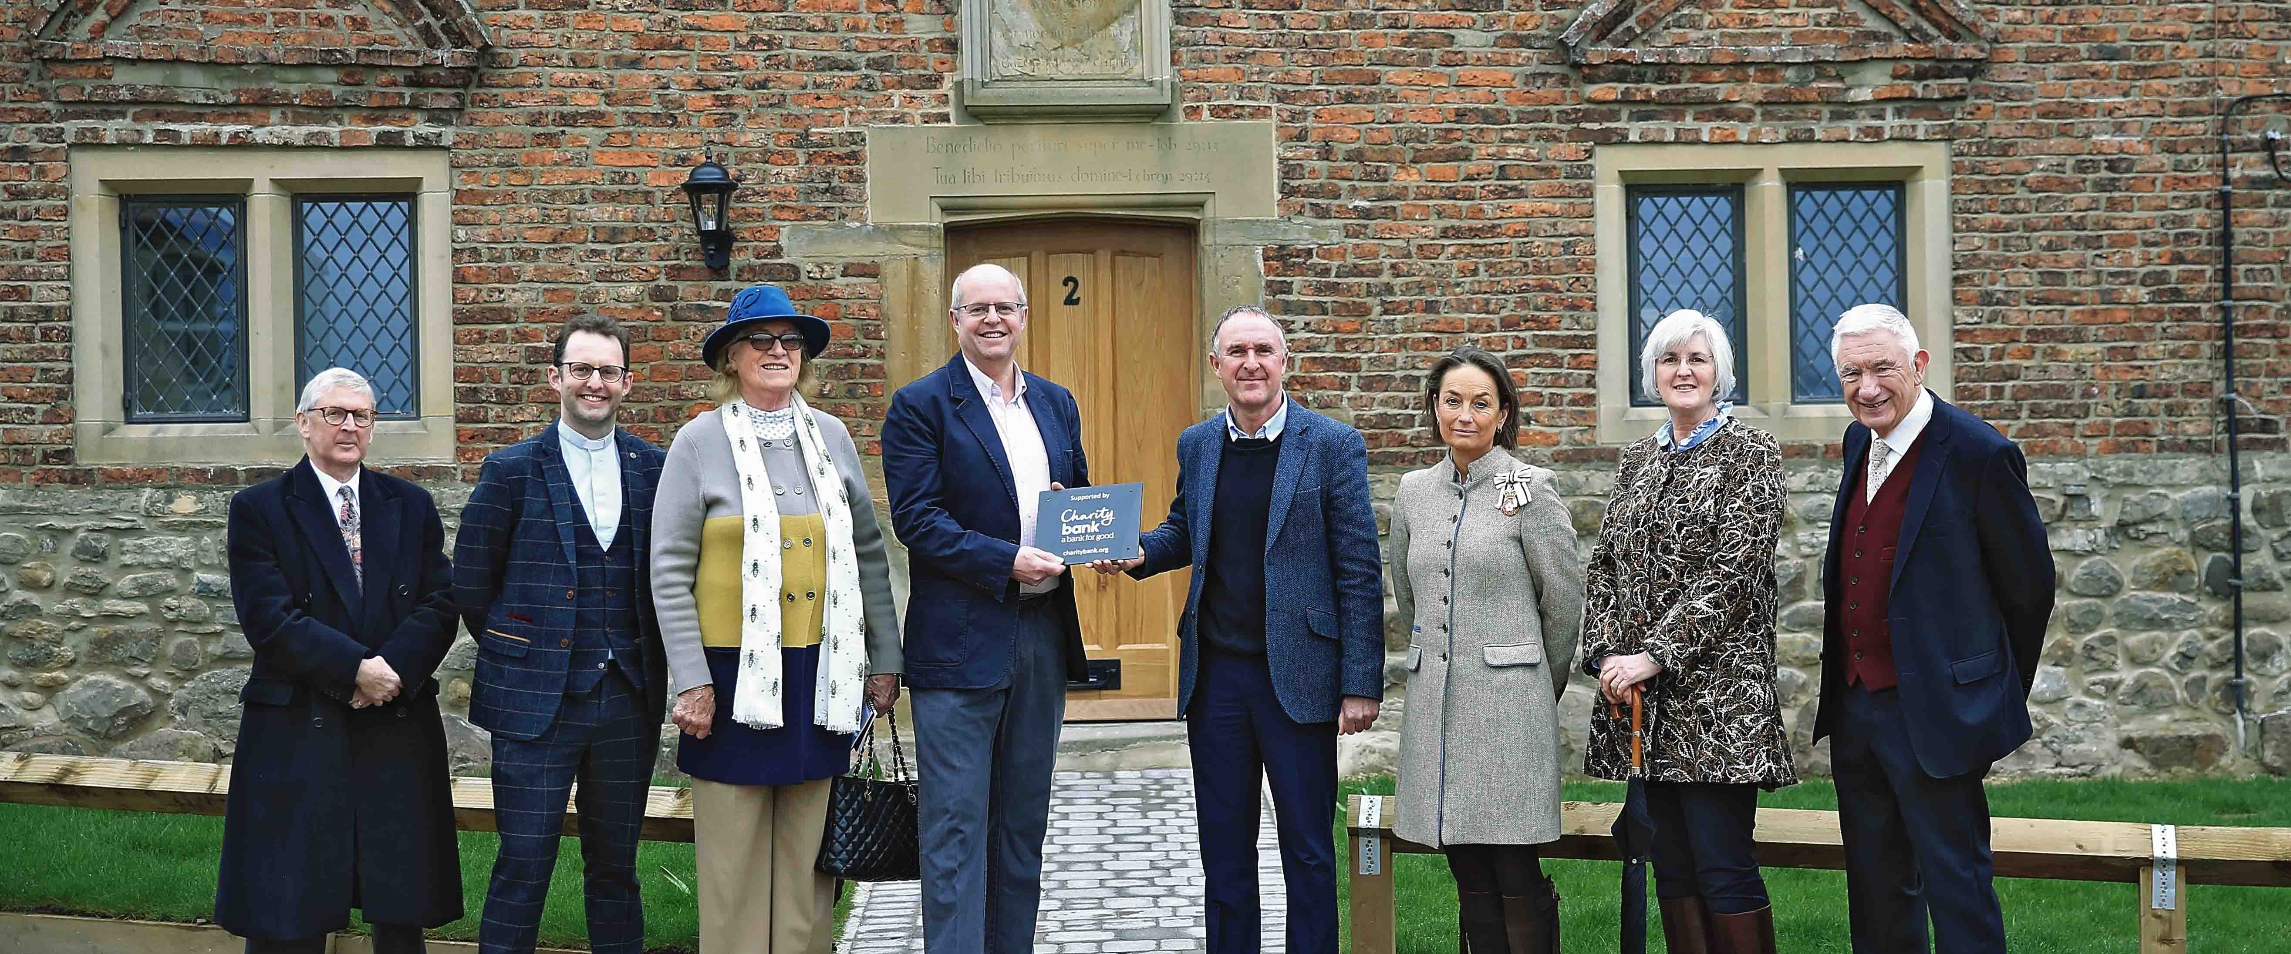
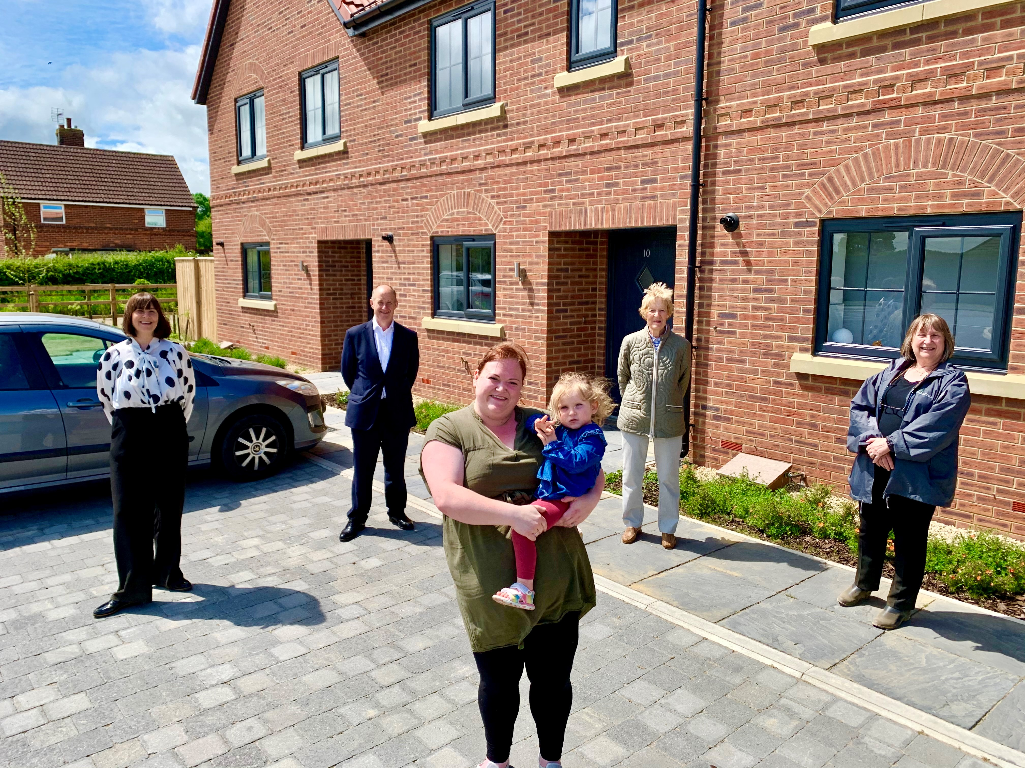
Working in partnership makes great things happen!

Slide 14
Time for a takeaway…
We’re here to stay in North Yorkshire, we invest in rural communities
We can help you realise your plans to deliver homes
We understand the complexities of rural delivery
And we work in partnership – all the time
We’d love to explore the art of the possible
Get in touch to see how we can work together!
Helen.fielding@broadacres.org.uk
Fiona.coleman@broadacres.org.uk

