Slide 1
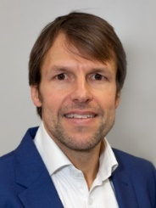
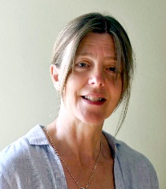
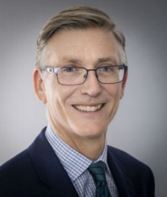
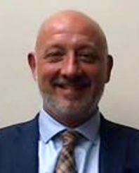
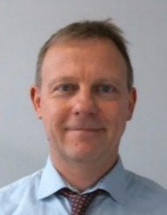
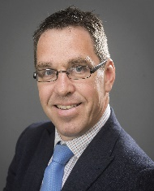
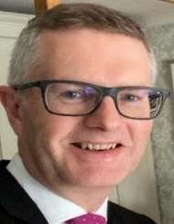
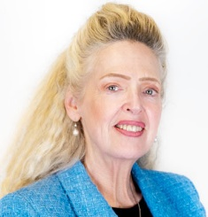
Community Development Directorate Senior Management Team
Nic Harne
Corporate Director
Jo Ireland
Culture, Leisure and Libraries Assistant Director
David Caulfield
Economic Development, Regeneration, Tourism and Skills Assistant Director
Trevor Watson
Planning Assistant Director
Andrew Rowe
Housing Assistant Director
James Farrar
Economic Partnership Unit Assistant Director
Paul Foster
Resources Assistant Director
Paula Lorimer
Director of Harrogate
Convention Centre

Slide 2
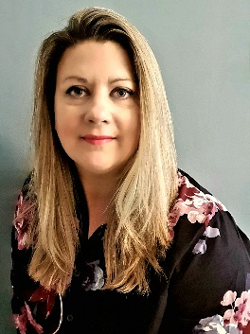
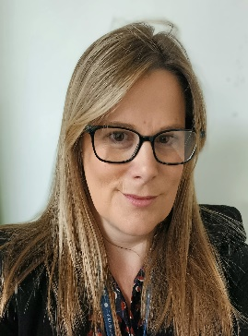
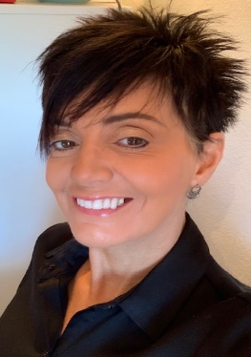
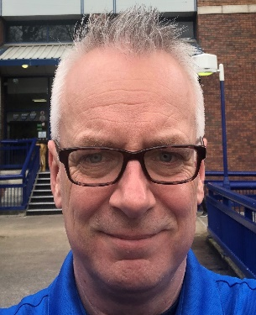
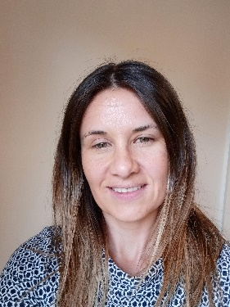
Community Development Directorate Housing Management Team
Andrew Rowe
Housing Assistant Director
Lorraine Larini
Head of Homes and Places
Lynn Williams
Head of Housing Renewal
Kim Robertshaw
Head of Housing Needs
Carl Doolan
Head of Housing Management and Landlord Services
Hannah Heinemann
Head of Housing Delivery and Partnerships

Slide 3
Key Priorities – Transformation
Bringing 8 Councils together
One Council Culture
Restructure across all teams (440 staff)
Efficiency, resilience, savings and fit for purpose
Management/IT systems
Maximising existing strengths and rolling out what works well
Grip/Performance/KPI's
Areas identified for savings (temporary accommodation, DFG)
Maximising opportunities for better join up with social care

Slide 4
Key Priorities – HRA and Regulator
Landlord of 8400 homes
Gap Analysis undertaken
Action Planning – key theme around data, on-going stock condition surveys
Investment Planning (external support)
Appetite and capacity for growth
Governance structures need firming up

Slide 5
Key Priorities - Growth
Housing Strategy being developed
Delivery Pipeline (reconciliation of existing work plus future opportunities via s106, public estate, RP led delivery, direct delivery, enabling, options appraisal around existing stock and other projects such as JV)
Work out fit between different partnership opportunities (RP Partnership, RHE, HBC's) - how can we take the best elements of these to meet shared objectives
As a collective we need to position ourselves to maximise the benefits of devolution
Join up – all the above is dependent on relationships
Open to ideas and very open to feedback

Slide 6
Future Activity
Policies, procedures, protocols
Allocation policy
Homelessness Strategy and Review
Consolidation and growth around energy efficiency opportunities – retrofit, social housing decarbonisation
Role of this Board within the wider Mayoral structures

