Slide 1
A Dr Chris Parsons Project
HOWGATE CLOSE
(9 Earth-Bunded Homes)
Bilsthorpe Road
Eakring
Newark
NOTTS
NG22 0DG

Slide 2
A Google Earth Image of Eakring, near Newark, Notts

Slide 3
A Google Earth Image of Eakring, near Newark, Notts

Slide 15
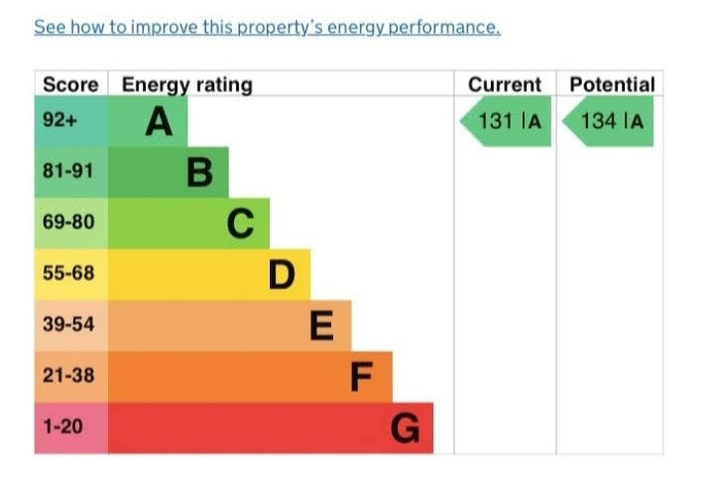

Slide 17
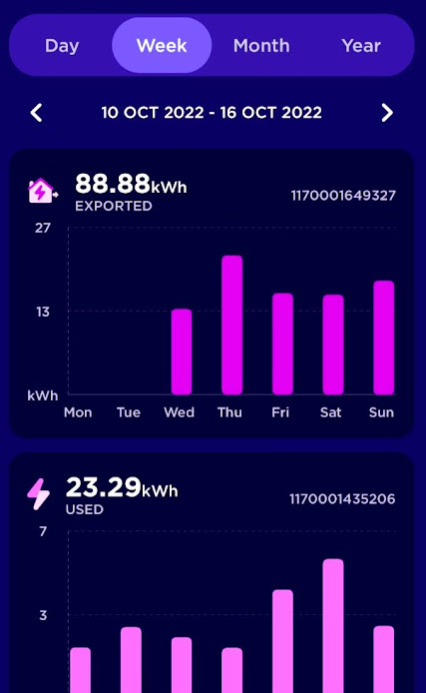

Slide 22
A Google Earth Image of Eakring, near Newark, Notts

