Slide 1
Draft North Yorkshire Housing Strategy 2024 - 2029
Sharon Graham, Housing Strategy Manager, North Yorkshire Council

Slide 2
North Yorkshire has…
619,542 people living in 274,381 households
Experienced limited population growth - up by 2.85%
Reducing household size - down to 2.24 people per household
An ageing population - 25% of population age 65 or over
Reduction in working age population - down by 2.6%
Ageing housing stock - 27% pre-1919
Over 108,000 residents limited by health and disability

Slide 3
Affordability
Average house price: £284,000 (median £250,000 in 2022)
Average annual household income after housing costs: £28,448 (£2,370 pcm)
Average monthly rent: £730 (median £675; LQ £575)
Median affordability ratio 8.49 in 2022
Median rents c. 28% of median income

Slide 4
Median affordability ratios 2018 - 2022

Slide 5
Median house prices 2022

Slide 6
Median earnings 2022

Slide 7
Median & LQ rents April 2022 - March 23

Slide 8
Rurality

Slide 9
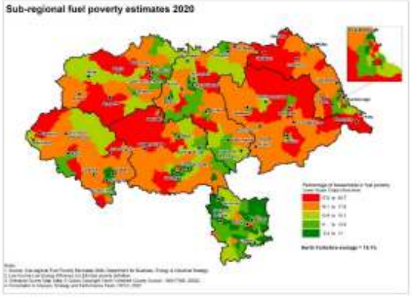
Inequality & fuel poverty

Slide 10
Opportunities & aspirations
New council with ambition provide new council homes & be an outstanding landlord
Partner with the new Mayor and Combined Authority to deliver growth
Explore potential of publicly owned land including NYC’s
Work with YNY Housing Partnership to deliver shared goals
Be carbon neutral by 2034
Tackling inequalities: health, social and digital exclusion
Making best use of resources

Slide 11
Our vision & themes
Our vision is to deliver ‘good quality, affordable and sustainable homes that meet the needs of all of our communities’
To do this we will work across three themes:
Our people
Our places
Our homes

Slide 12
Our people
Preventing and tackling homelessness:
Consolidating prevention & support services
Delivering new, innovative accommodation solutions
Ending rough sleeping
Homelessness Review & new Strategy by 2025
Meeting the needs of our ageing population:
New models of extra care (smaller rural, more complex needs)
Holistic approach with social care
Council’s housing offer updated
Meeting supported housing needs and the needs of specific groups:
Better integration of social and health care (Start Well, Live Well, Age Well)
Home Improvement Services
Independent living & assistive technology

Slide 13
Our places
Growing the supply of affordable and available housing:
Delivering at least 2,537 new homes pa (802 of which affordable)
HRA Business Plan ambition to deliver new homes
Looking at all opportunities to maximise housing supply
Addressing the rural housing crisis:
Supporting Rural Housing Enabler & community led housing
Partnering with Homes England, RPs and the Combined Authority
Supporting communities through neighbourhood renewal and regeneration:
Prioritisation of intervention areas
Work with communities on projects to improve their environment
Drive strategic regeneration projects

Slide 14
Our homes
Decarbonising our whole housing stock:
Social housing decarbonisation plan
Work with Homes England and RPs on warmer homes investment plans
Bid for funding to aid private sector housing decarbonisation
Ensuring that new housing supply contributes to our net zero housing ambitions:
Design codes
Building to Future Homes Standards and Nationally Described Space Standards
New Council and RP homes are EPC C or above
Addressing stock condition issues:
Retrofit action plan for private sector homes
Improving poor quality homes across all tenures
Working with the MCA to deliver the Carbon Abatement Pathway
Enforcement and selective licensing where necessary
Ensuring that Council homes remain decent and continue to improve:
Robust investment plan for Council homes
Eradication of damp and mould
Tenancy Strategy with high standards

Slide 15
Consultation & adoption
2nd October to 11th December
Online survey
Engaging with partners & stakeholders
Feedback analysis January 2024
Review strategy and develop focussed action plans
Adoption May 2024

