Slide 1
Housing Board
Changes to National Planning Policy
Photo: Clack Lane, Osmotherley (NYMNPA)

Slide 2
Changes to national policy – Headlines for Housing
First of series of ongoing consultations/proposals arising from the LURB
Government ‘stated’ commitment to delivering 300,000 homes a year by the mid-2020s
Nationally set method of calculating housing need no longer mandatory – LPAs can plan for less than full housing need to take account of “constraints”
LPAs with an up to date plan (no more than 5 years) will not have to demonstrate a 5 year housing land supply

Slide 3
Changes to national policy – Headlines for housing
Duty to co-operate to be replaced by ‘alignment policy’ (undefined at present)
LPAs will be able to take past over delivery (permissions) into account when setting targets
Government will publish data on developers who have failed to build out sites and possible financial penalties
Under delivery by developers could be taken into account in planning decisions

Slide 4
Changes to national policy – Headlines for housing
Framework to make clear that local planning authorities should give greater importance in planning for social rent homes
More support for older people’s housing/small sites/small builders/rural exception schemes
Consultations not prescriptive on these issues – asking how greater weight and improvements can be made
Higher standards of design through production and use of mandatory statutory design codes – part of the development plan – seeking to deliver “beauty”.
Changes to NPPF text to take place Spring 2023

Slide 5
Changes to national policy – Headlines for Local Plans
Shorter, faster Local Plans – to be completed in 30 months/can’t replicate national policy and higher bar for decisions contrary to local plan
New National Development Management Policies – to have same status as local plans in decision making
Reforms to take place in late 2024

Slide 6
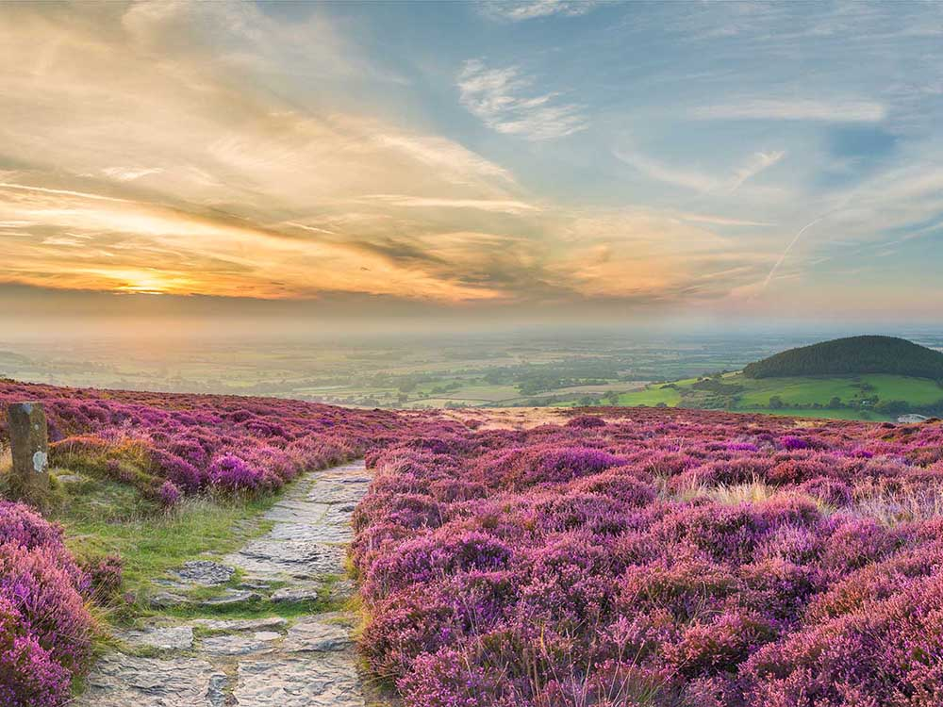
National Planning Policy Changes – Implications for housing delivery across North Yorkshire and York
Discussion
Photo: Cleveland Way from Live Moor, Thomas Heaton for Visit England
Notes:
Upland – is grouse shooting so intensive it affects special qualities?
Lowland – are we going to tackle intensification of pheasant shooting? If so, how?
How can it be managed in a way that is good for wildlife and climate change?

