Slide 1
York, North Yorkshire and the East Riding of Yorkshire Market Analysis and Affordability September 2021

Slide 2
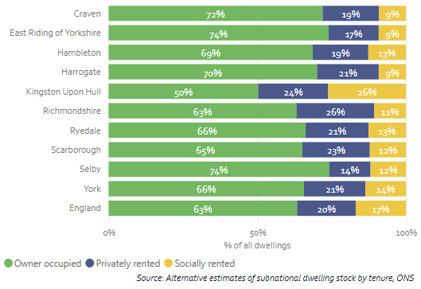
Dwelling Stock - ownership Homeownership remains high across much of North Yorkshire, with a lower proportion of social homes
Dwellings by ownership (2018)
Chart 1: Homes by type of owner (2018) – note this is an experimental dataset from the ONS and any reporting should reflect this.
Home ownership levels remain higher than average across much of North Yorkshire and the East Riding – with only Kingston upon Hull falling below the England average
There is relatively little difference between these authorities in terms of the proportion of private rented – although Hull, Scarborough and Richmondshire are between 3 and 5% higher than the national average
Kingston upon Hull has a significantly higher proportion of social rented homes (26%), with the rest below the national average

Slide 3
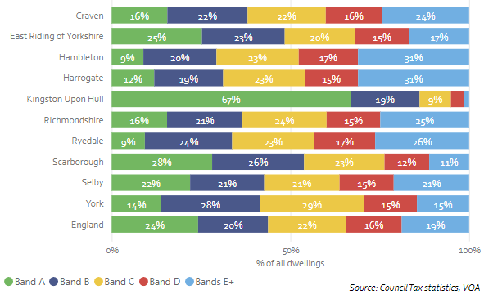
Dwelling Stock – Council Tax Band Council tax band – a useful proxy for the relative value of properties – shows a mixed picture across the area
Proportion of dwellings by Council Tax Band (2020)
Chart 2: Proportion of dwellings by Council Tax band (2020)
The proportion of dwellings by Council Tax band – a useful proxy for the relative value of properties within LAs – shows a mixed picture across North Yorkshire and the East Riding
Kingston upon Hull remains the outlier here with a very high proportion of lower value Band A housing Stock – although Scarborough and the East Riding continue to exceed the national average
Craven, Hambleton, Harrogate, Richmondshire and Ryedale all have a significantly larger proportion of higher value Band E stock than the national average

Slide 4
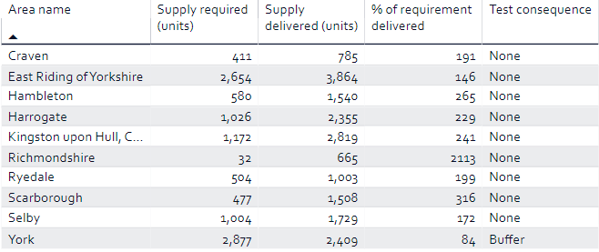
Housing Delivery (i) - Housing Need vs. Supply
Chart 1: Housing Delivery Test results 2017/18 -2019/20
All local authorities in North Yorkshire and the East Riding, with the exemption of York, have comfortably delivered sufficient homes to meet need according to the latest Housing Delivery Test.
The highest numbers of homes delivered over the three years to 2019/20 in the area have come in the East Riding (3,864), Hull (2,819) York (2,409) and Harrogate (2,355)
In the East Riding, Hull and Harrogate – this new supply has included significant levels of new affordable housing supply
Housing Delivery Test Results (2017/18-2019/20)

Slide 5
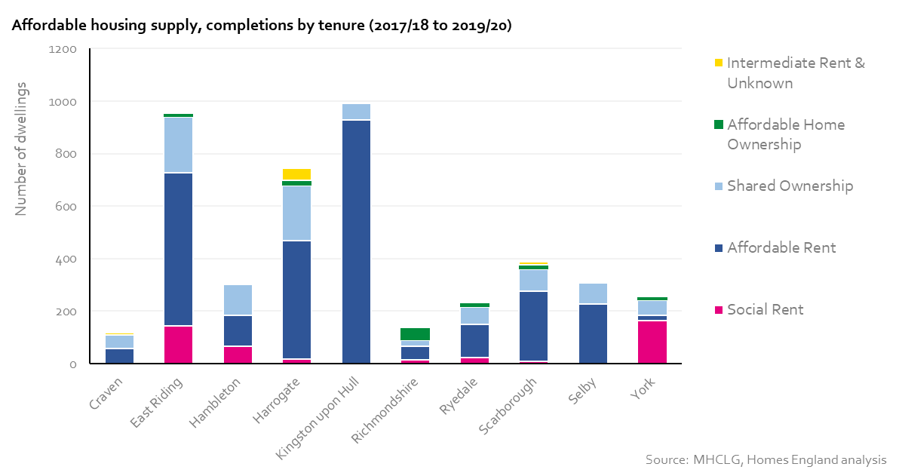
Housing Delivery (ii) – Affordable Housing Completions by Tenure East Riding, Hull and Harrogate drive new affordable housing supply over the past three years
Chart 1: Affordable Housing Supply, completions by tenure (2017/18 to 2019/20)
East Riding (957) and Hull (991), alongside Harrogate (743), have seen significant new affordable housing supply delivered over the past three years.
In the case of Hull and to a slightly lesser extent East Riding, this has primarily been driven by new Affordable Rented product – although East Riding and Harrogate have both delivered over 200 shared ownership homes in the past three years.
The lowest numbers of new affordable housing supply have been delivered in Craven (119) and Richmondshire (140)– although these are areas with significantly lower overall housing need (according to the latest Housing Delivery test)
York has seen the highest number of new social rented properties (165 – only East Riding being comparable at 145) – but continues to see a relatively slow rate of overall affordable delivery during this period
Please note the Ryedale figure (229 homes) is currently being rectified with MHCLG, it is understood the submitted figure should be 311 homes.

Slide 6
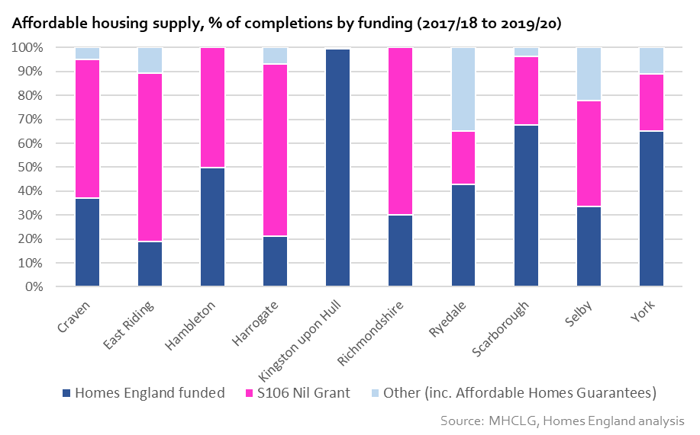
Housing Delivery (ii) – Affordable Housing Completions by Funding Just under half of new affordable homes funded through England – but this varies significantly by LA area
Chart 1: Affordable Housing Supply, % of completions by funding (2017/18 to 2019/20)
Just under 50% of new affordable housing supply across the whole area was Homes England funded (c.2,200 new homes) over the past three years.
This compares to 43% through s106 nil grant (c.1,900 new homes) over the past three years.
However, this varies significantly by authority, with Hull delivering almost all its new supply through Homes England funding, with a similar picture in York and Scarborough.
In comparison, the East Riding and Harrogate have both seen in excess of 500 new homes delivered through s106 nil grant over the past three years – and this form of funding remains well utilised elsewhere.

Slide 7
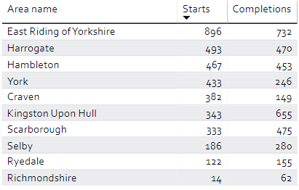
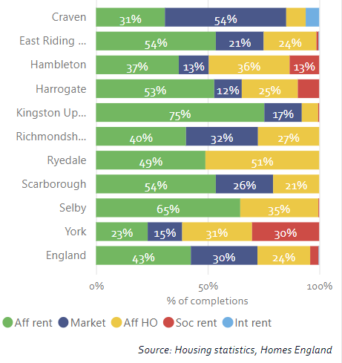
Housing Delivery (iii) – Agency intervention (all programmes) Affordable homes programme remains the dominant programme in the area
Homes England Starts and Completions (2018/19 – 2020/21)
Tenure of Homes England supported completions (2018/19 – 2020/21)
Looking at Homes England completions by tenure and programme, not unexpectantly Affordable Rent and the Affordable Homes Programme remain dominant in most areas
However, a significant proportion of market housing is being funded in Craven, Scarborough and the East Riding.

Slide 8
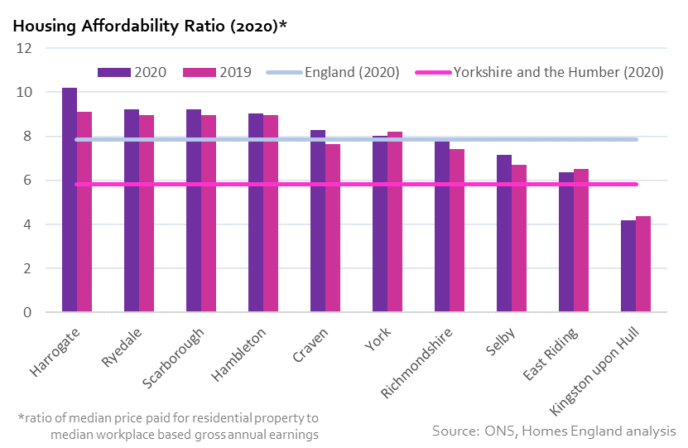
Housing Affordability The majority of North Yorkshire and East Riding authorities remain significantly less affordable than the national and regional average
Chart 1: Housing Affordability Ratio – workplace based, 2020 v 2019 comparison
Despite housing affordability improving between 2019 and 2020 across c.60% of local authorities across England & Wales – affordability continues to worsen across all Local Authorities in North Yorkshire apart from York, East Riding and Kingston upon Hull.
Harrogate, Ryedale, Scarborough and Hambleton have the least affordable housing overall, with each of these local authorities having an affordability ratio above 9 in 2020 (England 7.84).
The East Riding remains the most affordable, although only Kingston upon Hull is more affordable than the wider Yorkshire and the Humber region.
This measure of housing affordability for 2020 is based on house price data from the 12 month period to September 2020 and a snapshot of earnings data collected as at April 2020 (Annual Survey of Hours and Earnings).
Nationally, early estimates from the ONS on average weekly earnings show they grew year-on-year by 5.6% in the three month period to April 2021, however the annual rate of house price growth remains high

Slide 9
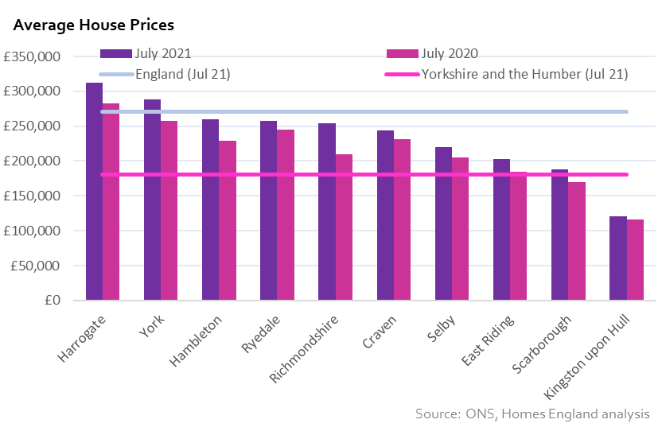
Average House Prices Average house prices remain polarised over the North Yorkshire and the East Riding
Chart 1: Average house prices – July 2021 and 2020 comparison (Source: ONS UK HPI, Latest: July 2021)
Average house prices remain polarised over the North Yorkshire and the East Riding – yet all but Hull exceed the regional average
In July 2021, only Kingston upon Hull (£121k) has an average house price lower than the regional average for Yorkshire and the Humber (£180k) – whilst the East Riding and Scarborough remain broadly in line.
Average house prices remain higher than the England average (£271k) in Harrogate (£312k) and York (£288k), with Hambleton (£260k) and Ryedale (£257k) within £15,000.

Slide 10
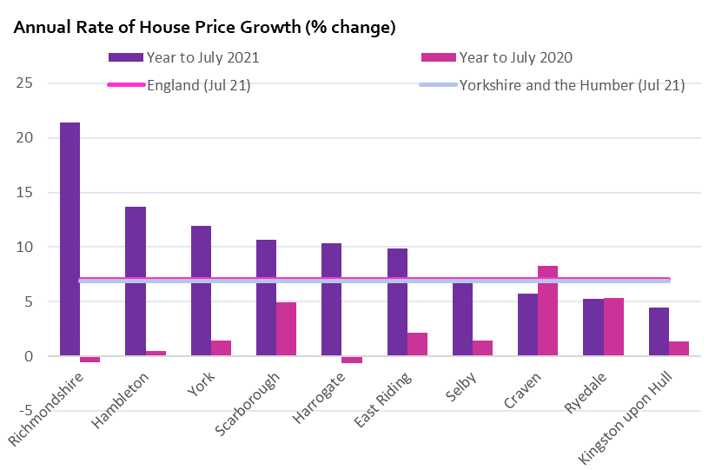
House Price Growth House prices growing at a faster rate than the national average across much of North Yorkshire and the East Riding
Chart 1: Annual rate of house price growth - ONS UK HPI (Latest: July 2021)
The latest ONS UK House Price Index reported that Richmondshire (+21%), Hambleton (+14%), York (+12%), Scarborough (+11%), Harrogate (+10%) and the East Riding (+10% have all seen the annual rate of UK house price growth exceed that national average for England (+7.01%) in the year to July 2021.
Richmondshire is one of only three local authority areas in England recording over 20% house price growth in the year to July 2021 (the others being Hastings and North Devon).
Whilst it is clear that has prices across the area are growing at a significantly faster pace than that recorded in the first half of 2020 (and throughout 2019) – we would urge significant caution when viewing this data at a local authority level
The rolling annual % change in house price growth so far in 2021 for these local authorities has been subject to significant volatility linked to the previous Stamp Duty holiday deadlines and most importantly the increased time lag in when transactions are registered with HM Land Registry (meaning the ONS house price index currently has larger changes at lower geographies owing to fewer transactions being used in the short term).
As such it may be some months before we can reliably interpret price changes here during 2021
Note: The house price data recorded within the ONS UK HPI is especially subject to backward revisions when derived at subnational geographies. This is currently likely to be exacerbated by the increased the time lag between the sale of a property and its registration with the Land Registry.

