Slide 1
The Starfish Group Presentation – York, North Yorkshire & East Riding Housing Forum 23/05/16

Slide 2
Agenda
The Starfish Group
Completed + Current New Build Schemes
Re:allies framework
Retro-fit
Questions
Close

Slide 3
The Starfish Group

Slide 4
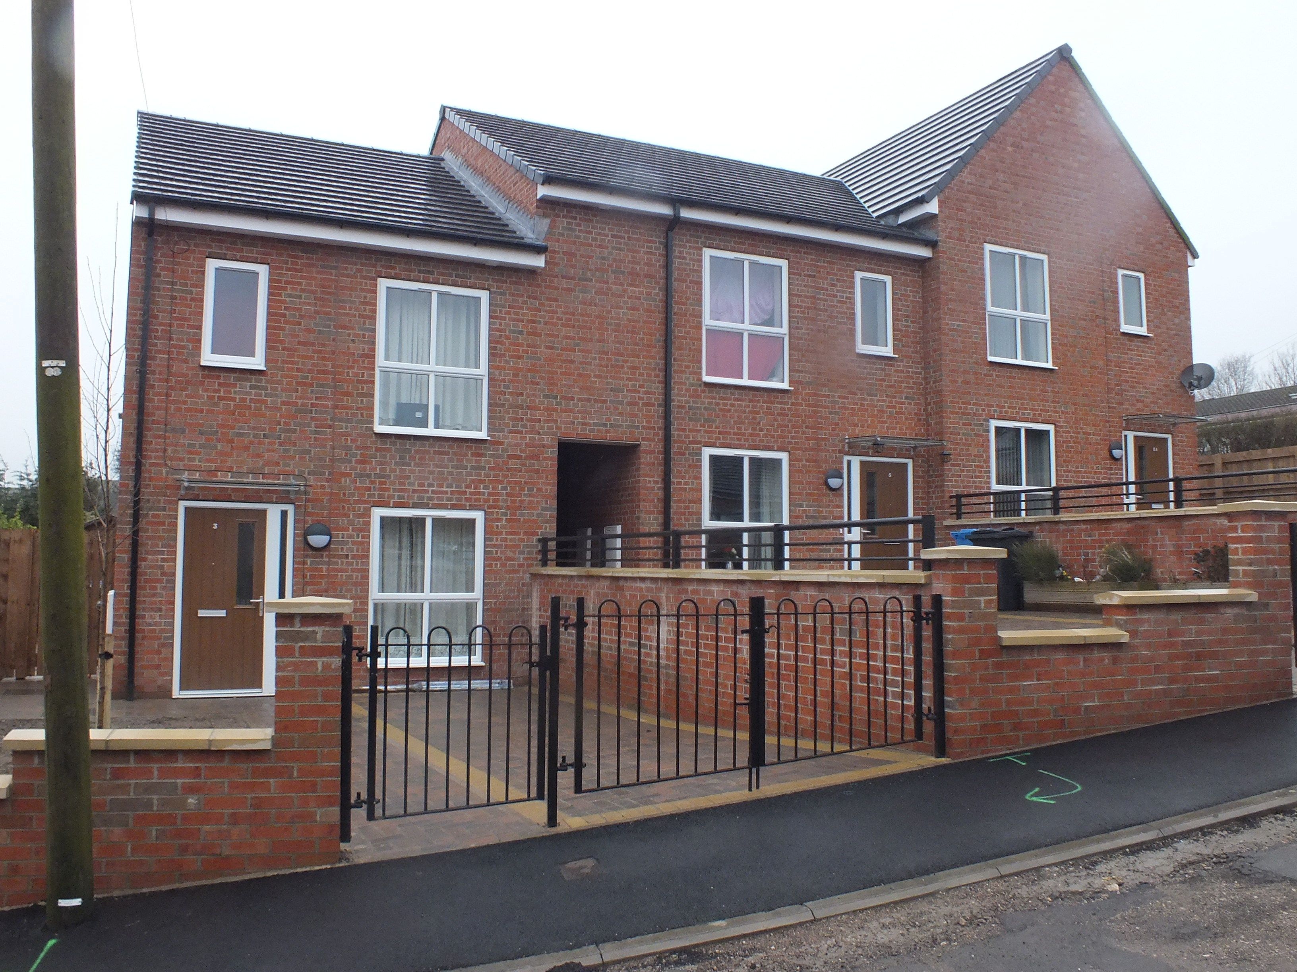
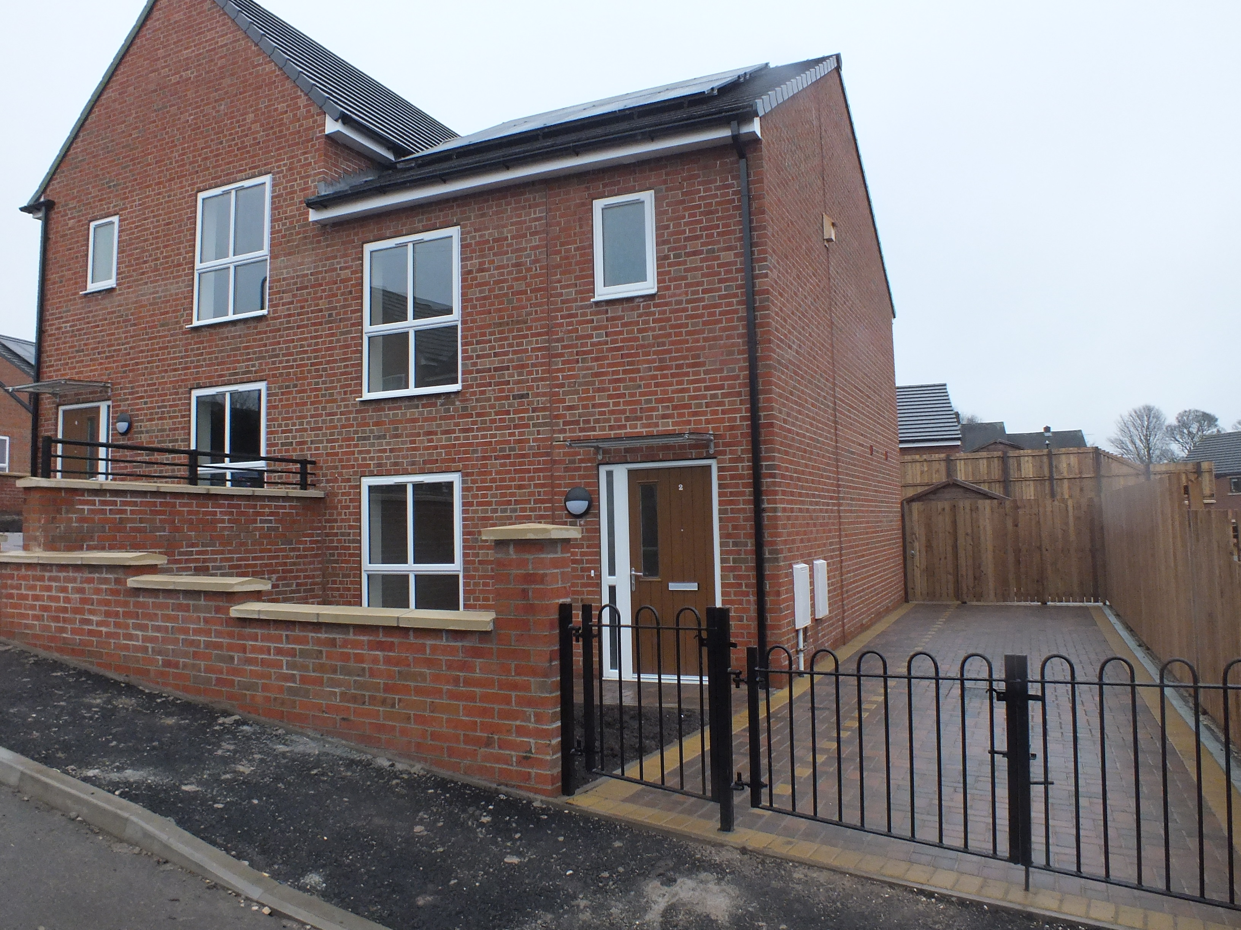
Lee Road – Synergy Housing (part of Together Group)

Slide 5
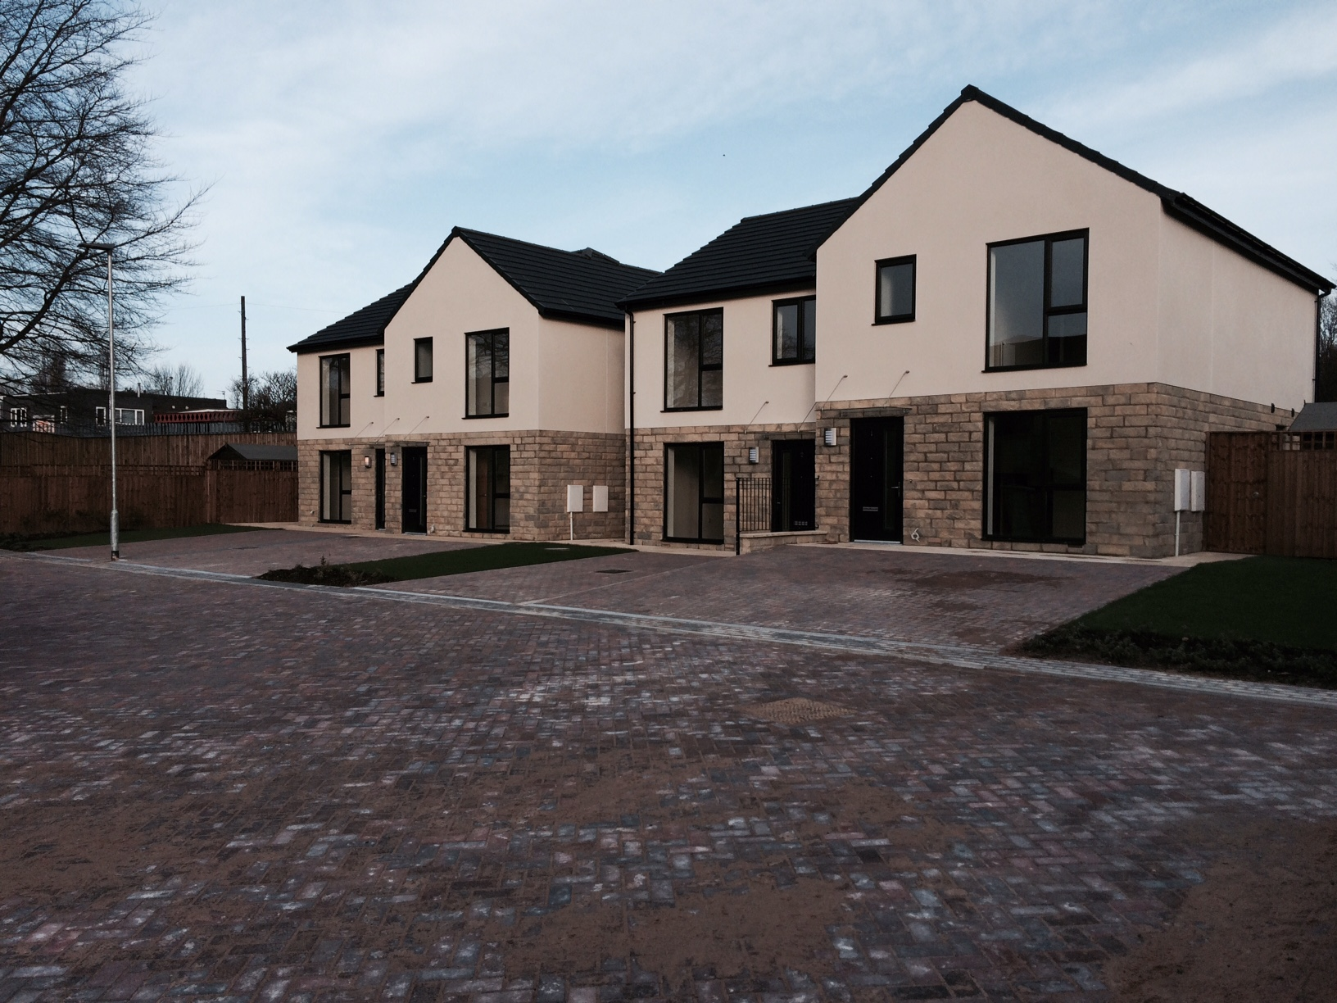
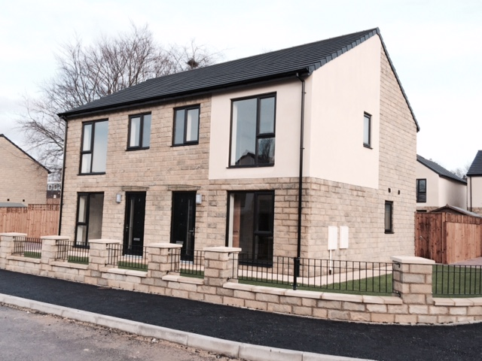
Balne Lane – Yorkshire Housing

Slide 6
Saddleworth Close – Riverside Group

Slide 7
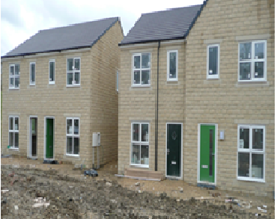
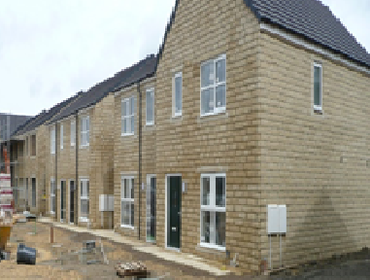
Soothill – Yorkshire Housing

Slide 8
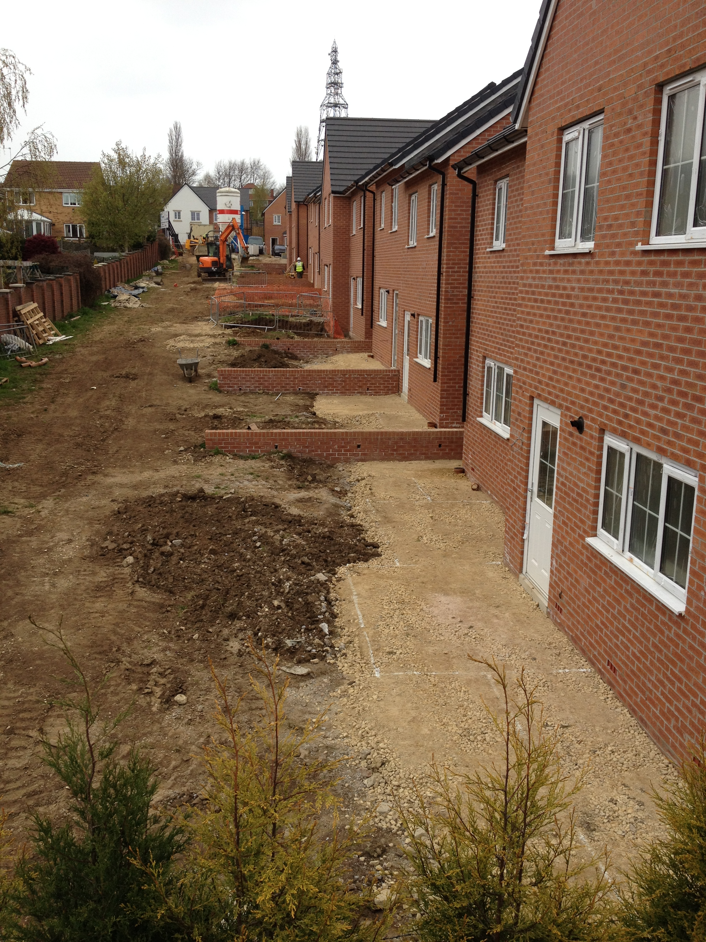
Marguerite Gardens – Yorkshire Housing

Slide 9
Re:allies Framework
1st on price, 2nd on quality and 2nd Overall
OJEU Compliant Framework
http://www.re-allies.com/

Slide 10
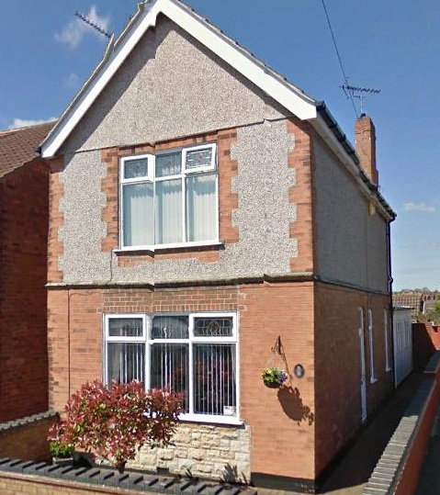
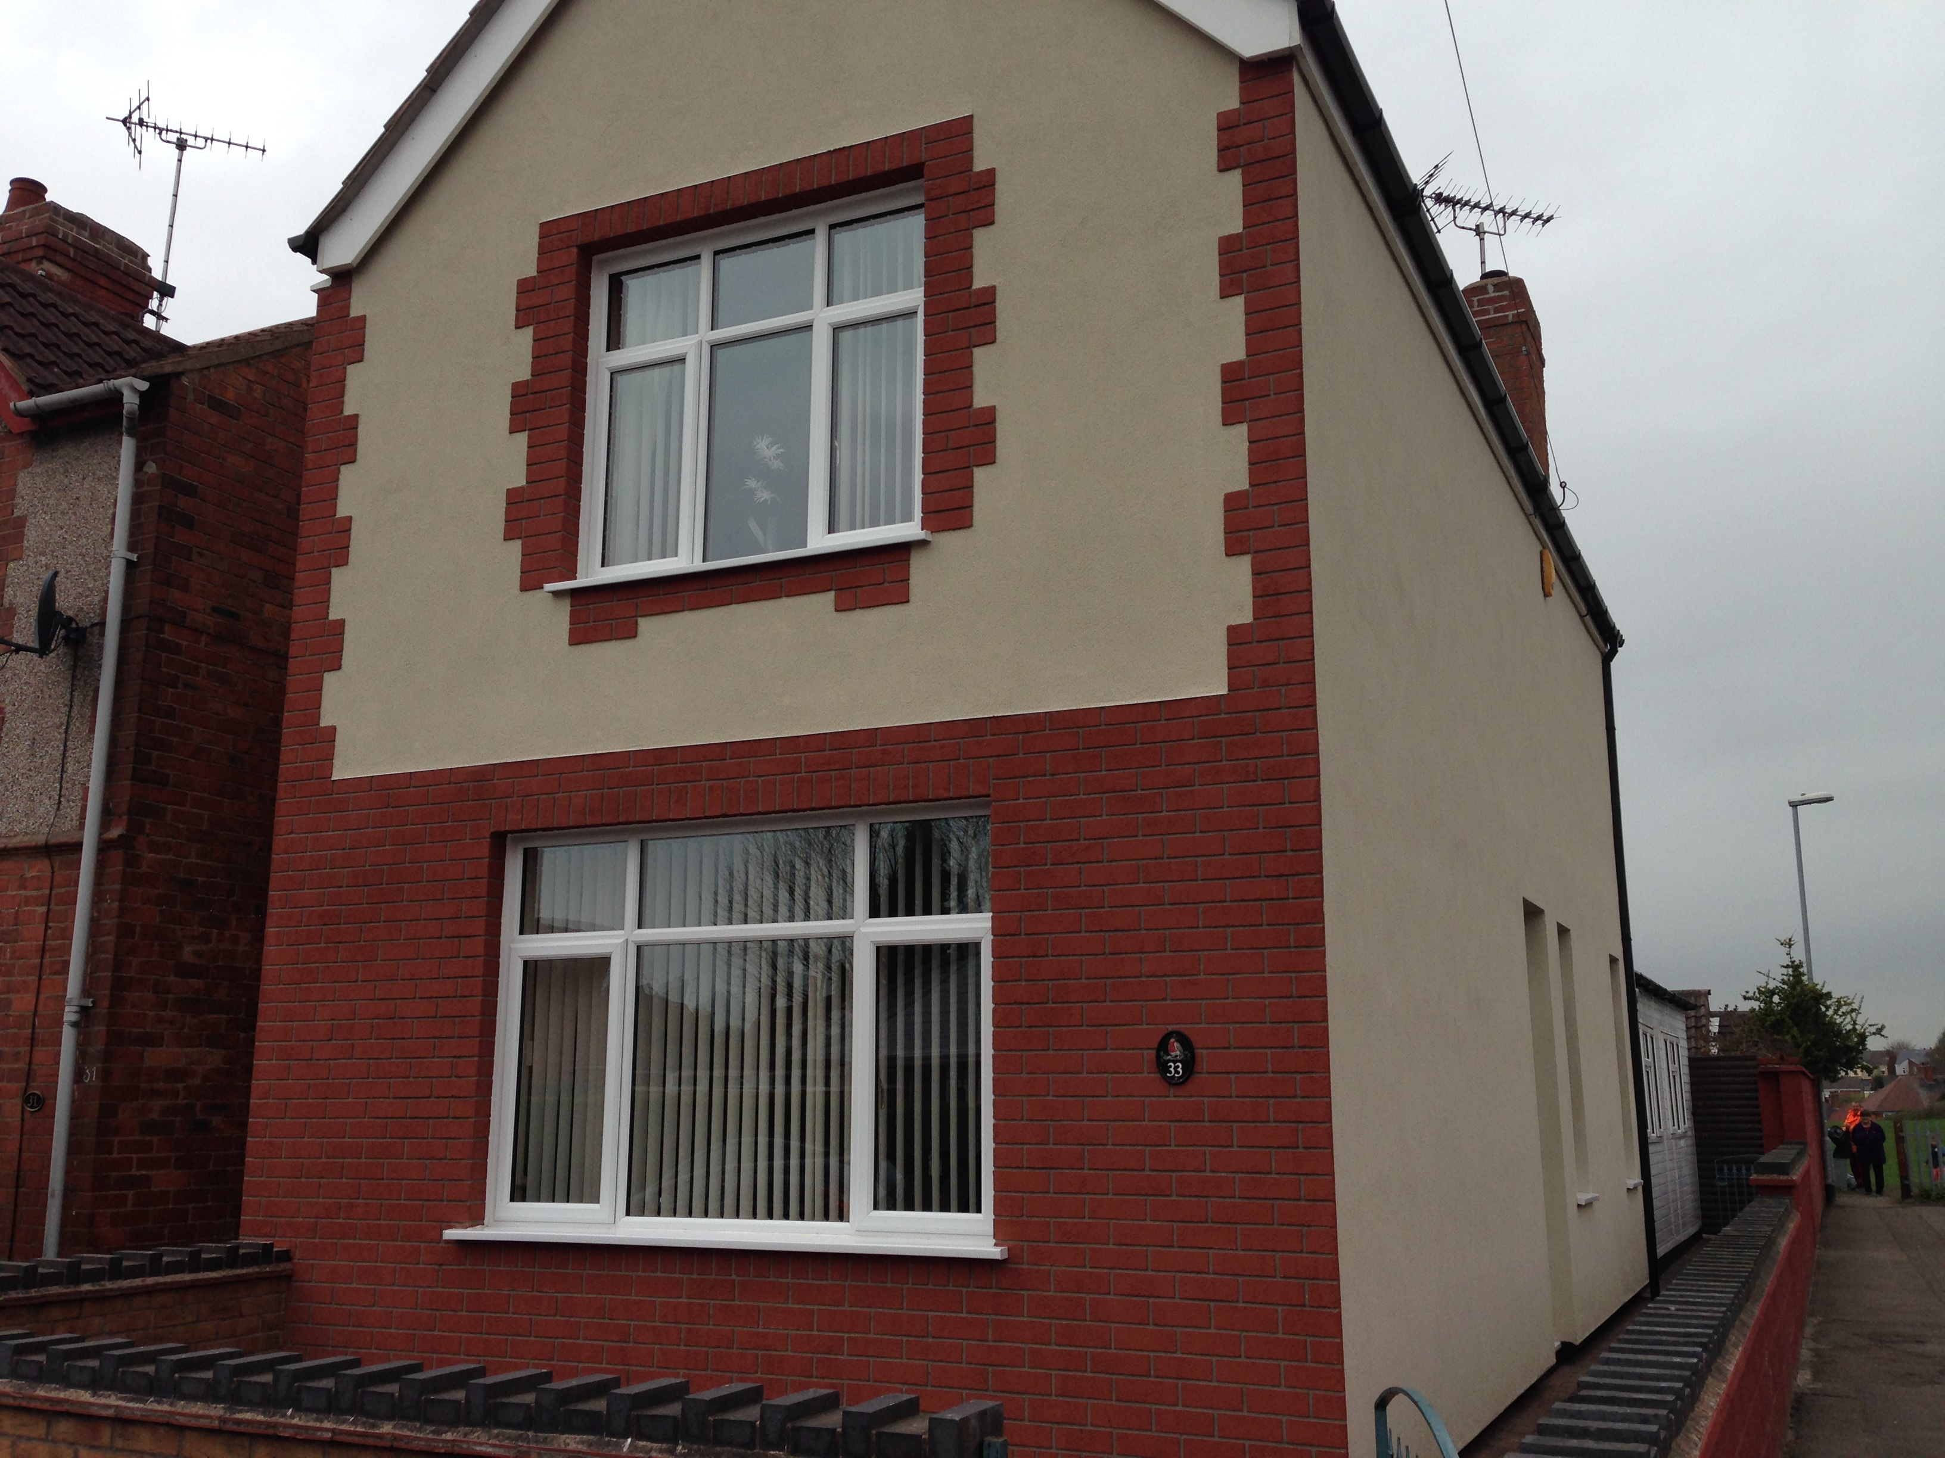
Starfish GDCF and ECO scheme
BEFORE AFTER

Slide 11
Customer Comments
27 Hillcrest: “House is warmer. Stays warmer for longer. We use far less gas. The team was very helpful and polite.”
16 Deepdale: We are more comfortable and it looks great. The installation team were a great set of lads.”
22 Queens Street: “I hardly put on my heating now. The heat stays in my house much longer now and my house looks great.”
16 Laxton Drive: “Made a difference to my bills and has got rid of the condensation.”

Slide 12
Thank you for your time – any questions?
Contact – Karl Apps
Email – Karl@starfish-group.co.uk
Mobile: 07985 268119
Website: www.starfish-group.co.uk

