Slide 1
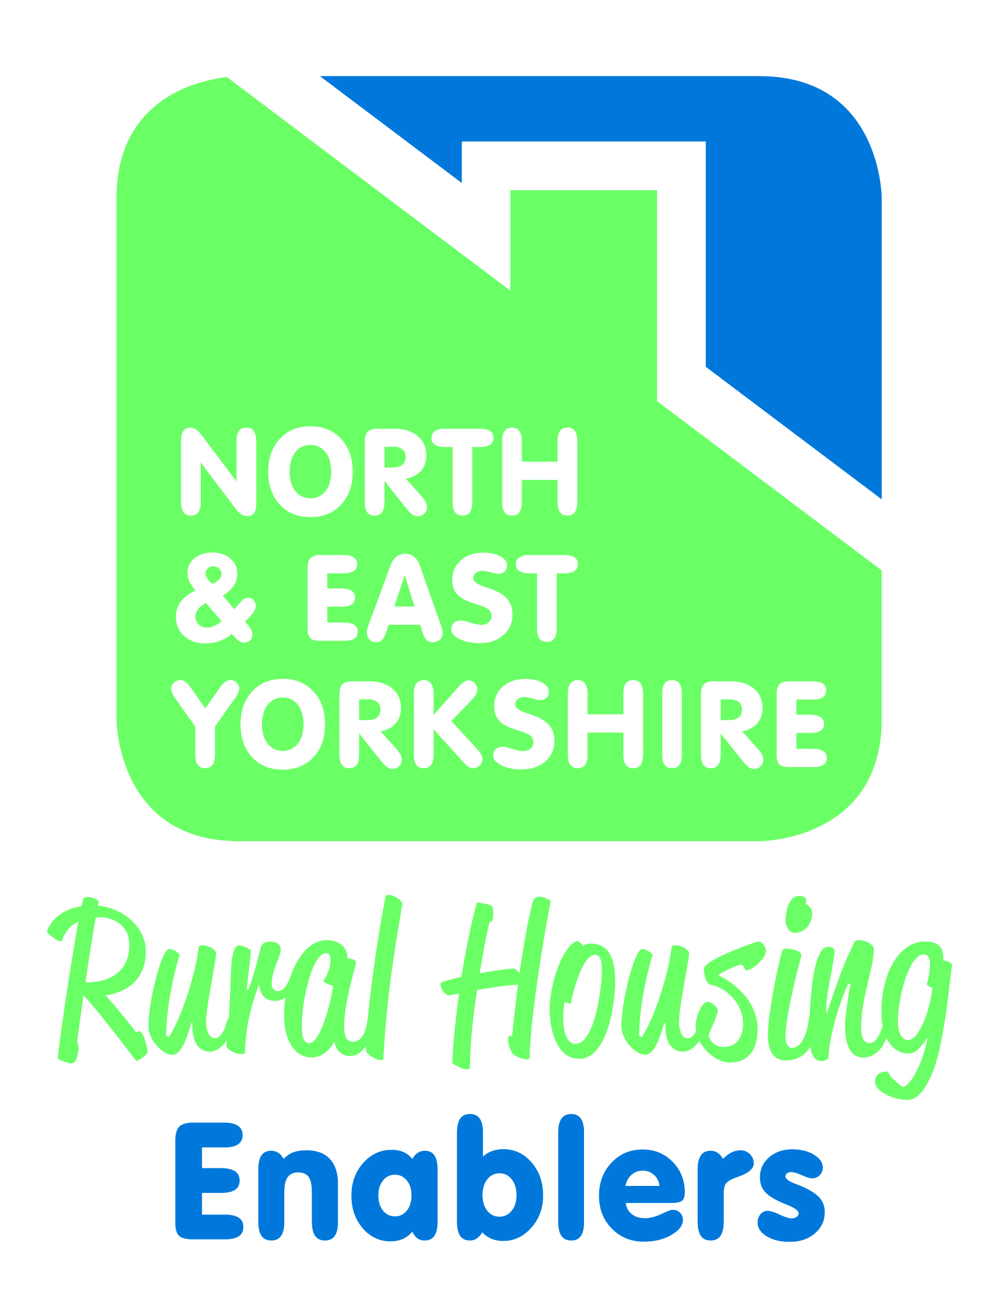
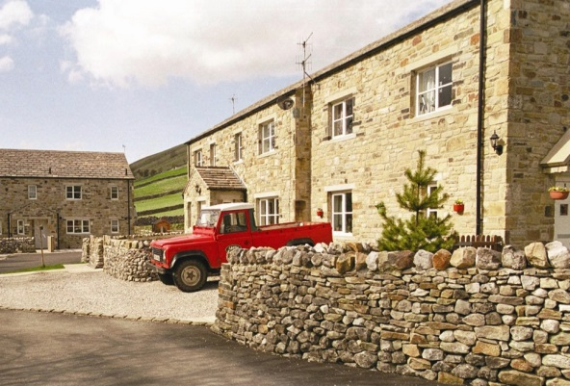
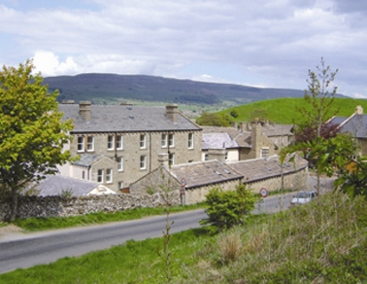
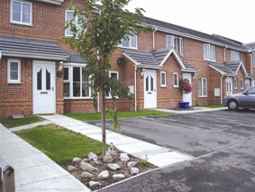

Slide 2
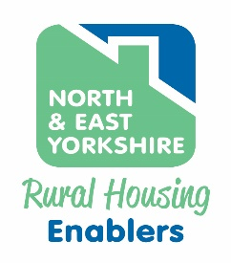
The North & East Yorkshire
RHE Partnership
Longstanding partnership
Track record of delivery
Dedicated team of RHEs, embedded within local councils, covering North and East Yorkshire
Nationally recognised model
Funded by local councils, National Parks and 15 housing association partners
Homes England approved

Slide 3
Delivery pathways & support
Local Plan allocated site
Mix of market & affordable homes
Privately financed
Developers working in partnership
Landowners
Private developers
Housing Associations
Community Led Housing organisations
Sources of Support:
Rural Housing Enablers
Housing Associations
Community Led Housing Hub
Rural Exception Site
Not normally considered for development
100% affordable to meet local needs
Access to grant

Slide 4

Our Independent Rural Housing Enablers can..
Help explore options to find the one that works best for you
Undertake local housing need surveys
Provide initial advice on site suitability
Encourage & facilitate parish council & community engagement
Help find a Housing Association that you feel comfortable working with
Explain how the planning, funding, viability & allocation processes work
Help you explore how you could retain land ownership & have nomination rights for some of the affordable homes
Liaise with local planning & housing authorities
Act as an honest broker between different parties to find solutions

Slide 5
The CLH Hub can …
Help find a Community Housing model that works for you
Support community engagement
Provide technical advice & guidance from initial concept, to setting up the necessary legal entity & delivery
Access to a panel of technical experts, including architects, solicitors, energy efficient construction & retrofitting
Peer support & access to other successful projects

Slide 6
Some examples of our RES work
Wellington Close, Danby:
Dawnay Estate
Browns Wood Cottages, Egton:
Mulgrave Estate

Slide 7
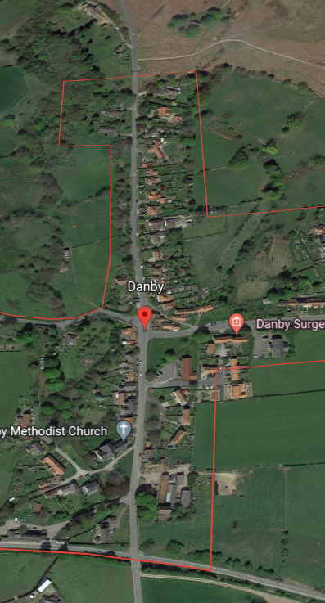

Rural Housing with the Dawnay Estate
Wellington Close, Danby 2010
Danby Group Parish serves the rural communities of Danby, Castleton, Westerdale and Commondale in the Esk Valley. It is also in the NYM Nat Park with a population of 1500.
The Parish Council conducted a Parish Plan in 2002 which highlighted a need for affordable housing for local people.
RHE recruited in 2004 and started to work with the Parish Council on a housing survey which confirmed the need.

Slide 8
The Challenge
The survey showed significant need in the parish so the challenge was to find one or more sites to meet that need.
The RHE organised a tour of the parish settlements with the Parish Council and NP planners. Two sites were eventually identified with willing landowners, one in Castleton owned by Scarborough Council and the other in Danby owned by the Dawnay Estate.
The Estate didn’t want to sell the land so the challenge was to find another option that worked for both parties. The then Housing Corporation had also implemented a cap of £5K per plot on what an RP could pay for an exception site development.

Slide 9
The Solution
The RHE brought the Estate and Sanctuary Housing together to discuss what would be the best solution.
It was agreed that a long lease of 125 years would be the best option with the RP also paying a nominal ground rent for the scheme.
An open day consultation event was undertaken with the local community in 2006 with both sites receiving very good support.
Planning approval granted in Dec 2007 for the Danby site, with the development being completed in early 2009.

Slide 10
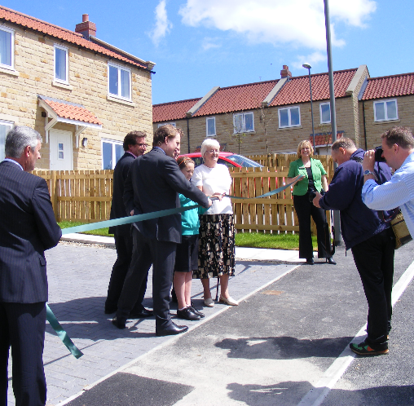
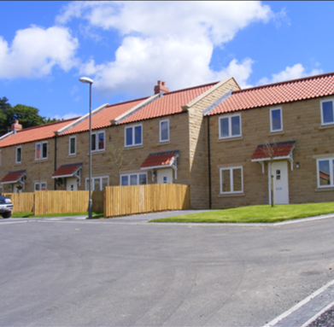
The Outcome
The scheme consisted of a terrace of 3 three bedroom and 1 two-bedroom dwellings and a pair of semi-detached three-bedroom properties. All the homes for affordable rent.
The RHE organised an allocation event just before the homes were completed so local people could register on NY Home Choice. A Section 106 Agreement was also drawn up.
An opening ceremony was held in June 2009 with Lord Downe cutting the ribbon together with the chair of the Parish Council.
The scheme was included in the then Prince of Wales’s Affordable Rural Housing Initiative for good practice highlighting partnership working with Estates and housing associations.

Slide 11
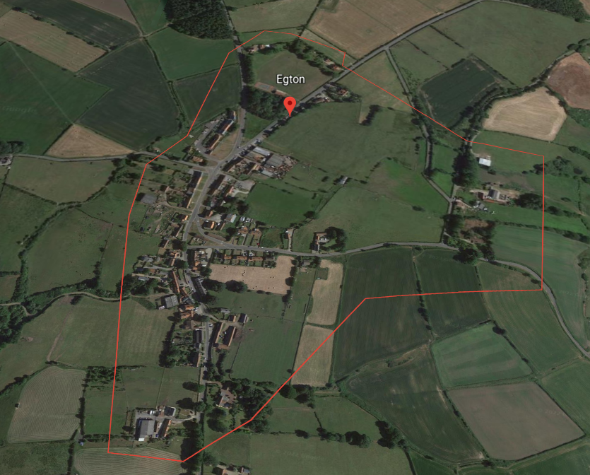
Rural Housing with the Mulgrave Estate
Browns Wood Cottages, Egton 2015
Egton parish lies about 5 miles west of Whitby and is located within the North York Moors National Park. The parish includes the villages of Egton and Egton Bridge and has a population of approx. 480.
Work on this scheme started back in 2009 when the RHE discussed the importance of rural affordable homes with the Parish Council.
A parish survey identified 22 local households with a housing need..

Slide 12
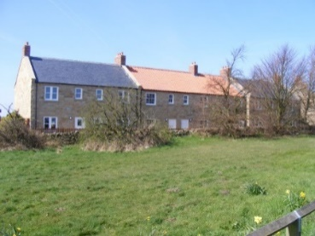
The Challenge
Once the need was established, the RHE organised a tour of the two settlements with the Parish Council and NP planners. A preferred site in Egton, owned by the Mulgrave Estate, was identified.
At the time, the Estate had a problem with several run down farmsteads in the area occupied by semi-retired estate workers of pensionable age. The rental income was so low that the Estate was not modernising the properties and younger local tenants were not able to take over, to the detriment of the local farming economy.
The challenge was to help the Estate to relocate these households to more suitable accommodation that met their needs and to provide affordable homes for the community.

Slide 13
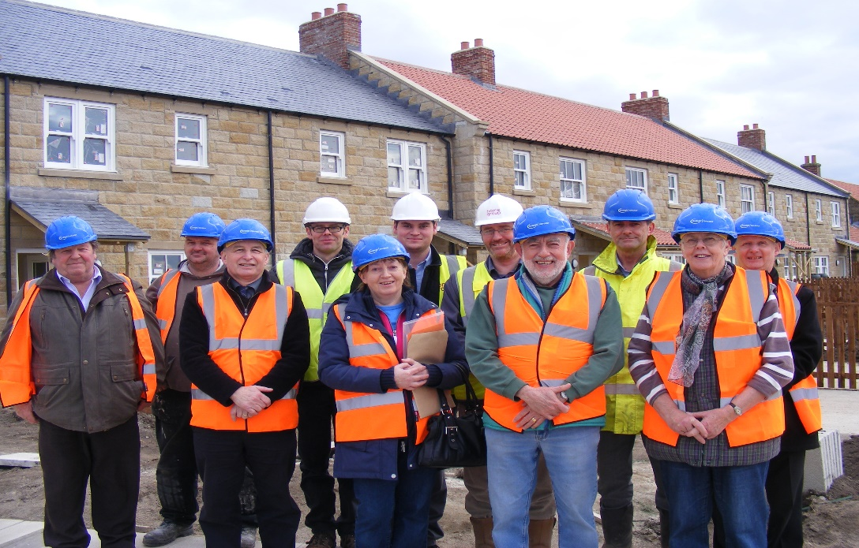
The Solution
By releasing the land, it was agreed that the Estate would have nomination rights in perpetuity on 4 affordable properties suitable for such people if they wanted to move. This released the farmsteads for the Estate to either retain or convert to other uses.
This was agreed by the NP Authority as long as policy requirements were met so that the homes were for local people in need of an affordable home. Some of the tenant farmers lived in Egton but others lived in nearby parishes so it was agreed to include more than one parish in the top cascade of the S106.
The RHE kept the Parish Council informed at every stage of negotiations and this was made clear at a pre planning consultation open day in the village.

Slide 14
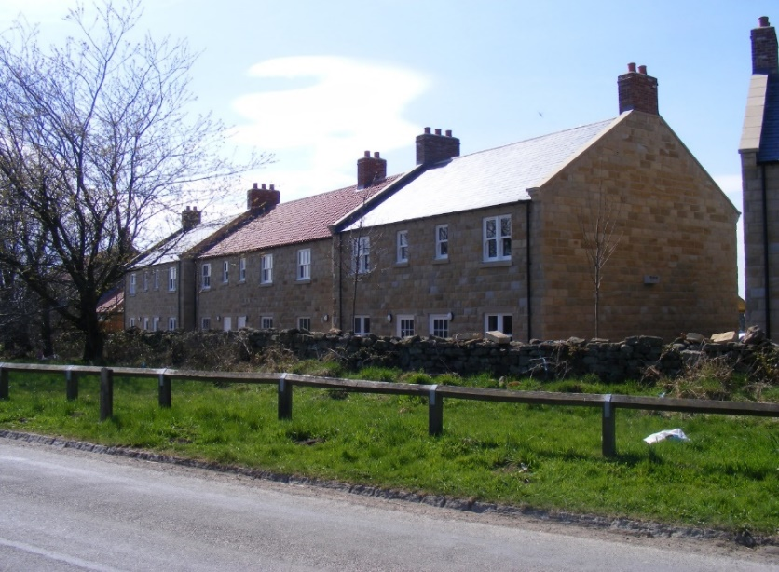
The Outcome
Planning consent was granted in 2014 and the scheme completed in 2015 with the Parish Council invited to tour the properties just before the homes were finished
10 affordable homes were built consisting of 7 two-bedroom houses, 1 three-bedroom house and 2 two-bedroom apartments
All the properties are managed by Home Group
The RHE organised an allocation event for the development.
The Estate had nomination rights in perpetuity on 4 of the units. If after 30 days the Estate couldn’t put forward a nomination then Home Group would be able to advertise the property to the parish and surrounding parishes.

Slide 15
Thank you for listening
– are there any questions?
colin.huby@scarborough.gov.uk
colin.huby@ryedale.gov.uk
http://www.nycyerhousing.co.uk/rural-affordable-homes/rhe-news/

